Slide 1







Tools for Transformation
Simple and practical ways for your church to care for God’s earth

Slide 2


WELCOME
To all those who have come of hear about Eco Church, the Big Church Switch and what other churches are doing in Caring for God’s Creation
Tools for Transformation : :

Slide 3
Purpose of Evening
Tools for Transformation
Equip Agents of Change
Provide resources
Help, encouragement & sharing
Tools for Transformation : :
Notes:
We hope this event we’ve entitled Tools for Transformation will help you both as individuals and also corporately together as churches. You represent the agents of change who can impact the churches and communities you represent in terms of helping us collectively better care for and stewardship this planet (our common home) recognising this is God’s creation that He wants us to look after on His behalf.
I’d also like to stress – this is not all we are doing. We are running similar events to this in the next few weeks in Southampton, Bournemouth, Andover and Winchester as well as five further events across Dorset.
We want to be able to equip you not just this evening but going forward. So (next slide)…

Slide 4

Tools for Transformation : :

Slide 5
Outline of Evening
Brief Worship
Ruth Valerio – A Rocha UK
  Why Care
  Eco Church
Charlotte Scott – Christian Aid
  Global Impact
  Big church Switch
What are churches currently doing?
  Nursling & Rownhams
Tools for Transformation : :

Slide 6
Great is thy faithfulness, O God my Father;
there is no shadow of turning with thee;
thou changest not, thy compassions, they fail not;
as thou hast been thou forever will be.
Tools for Transformation : :

Slide 7
Great is thy faithfulness! Great is thy faithfulness!
Morning by morning new mercies I see;
all I have needed thy hand hath provided;
great is thy faithfulness, Lord, unto me!
Tools for Transformation : :

Slide 8
Summer and winter and springtime and harvest,
sun, moon and stars in their courses above
join with all nature in manifold witness
to thy great faithfulness, mercy and love.
Tools for Transformation : :

Slide 9
Great is thy faithfulness! Great is thy faithfulness!
Morning by morning new mercies I see;
all I have needed thy hand hath provided;
great is thy faithfulness, Lord, unto me!
Tools for Transformation : :

Slide 10
Pardon for sin and a peace that endureth
thy own dear presence to cheer and to guide;
strength for today and bright hope for tomorrow,
blessings all mine, with ten thousand beside!
Tools for Transformation : :

Slide 11
Great is thy faithfulness! Great is thy faithfulness!
Morning by morning new mercies I see;
all I have needed thy hand hath provided;
great is thy faithfulness, Lord, unto me!
Tools for Transformation : :

Slide 12
Reflection
Colossians 1:15-20
Tools for Transformation : :

Slide 13
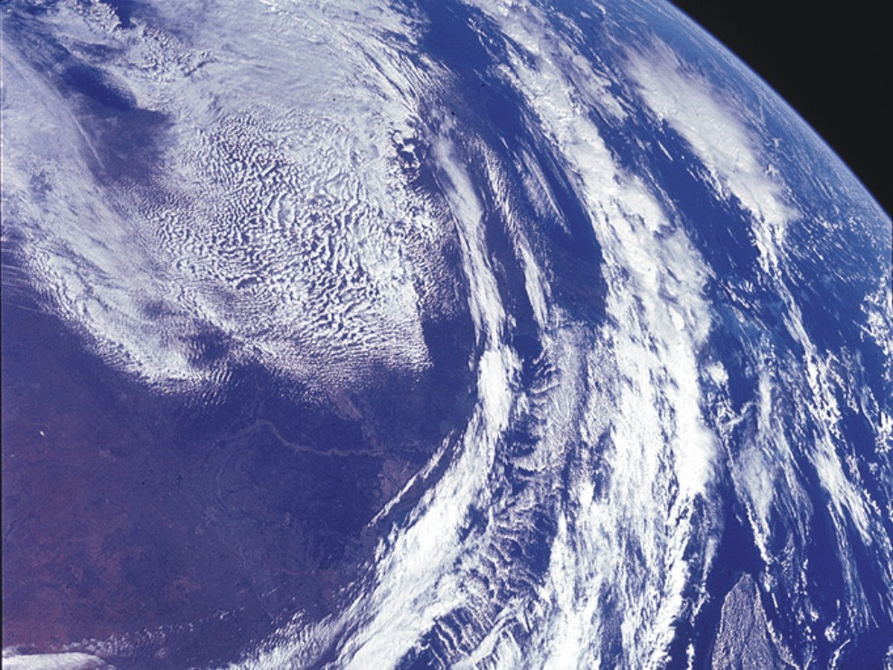

He is the image of the invisible God, the firstborn over all creation.
Notes:
Passage: Colossians 1:15-20
Music: An appropriate musical accompaniment is the choral work Agnus Dei by Samuel Barber (1910-1981), using the first few minutes. Can be downloaded for 79p from Tescos web site:
http://www.tescodownloads.com/servlets/2452328105705Dispatch/53/Call?htmltemplate=./content/v_content.html&t=TRACK&lmid=6600554
Copyright (c) 2007 A Rocha and its licensors. All rights reserved.
[This statement is requested by the producers of Corel Draw software, covering the use of a couple of the graphics that are Corel clip arts]
NASA images from space:
http://visibleearth.nasa.gov/useterms.php
NASA Terms of Use
For all non-private uses, NASA's Terms Of Use are as follows:
The imagery is free of licensing fees
NASA requires that they be provided a credit as the owners of the imagery
Visible Earth Addendum
Beyond the NASA Terms, the Visible Earth team requests, but does not require:
The Visible Earth be provided a credit as the location that the imagery was found at
A URL be provided, either to the Visible Earth (http://visibleearth.nasa.gov/) or to the page providing the link to the used image.

Slide 14
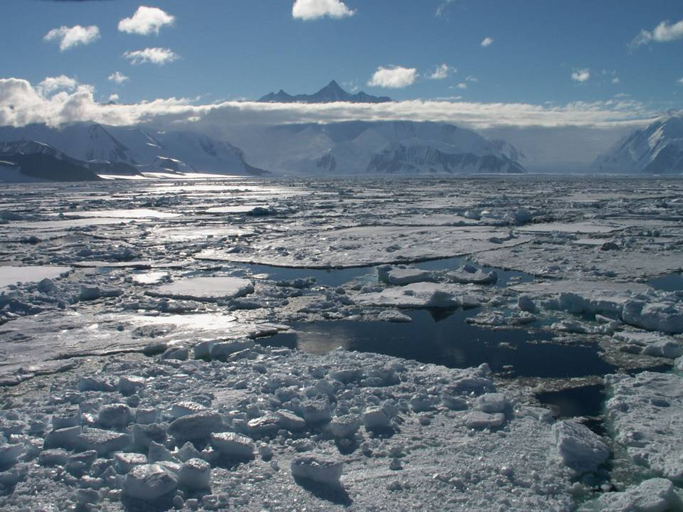
He is the image of the invisible God, the firstborn over all creation.

Slide 15
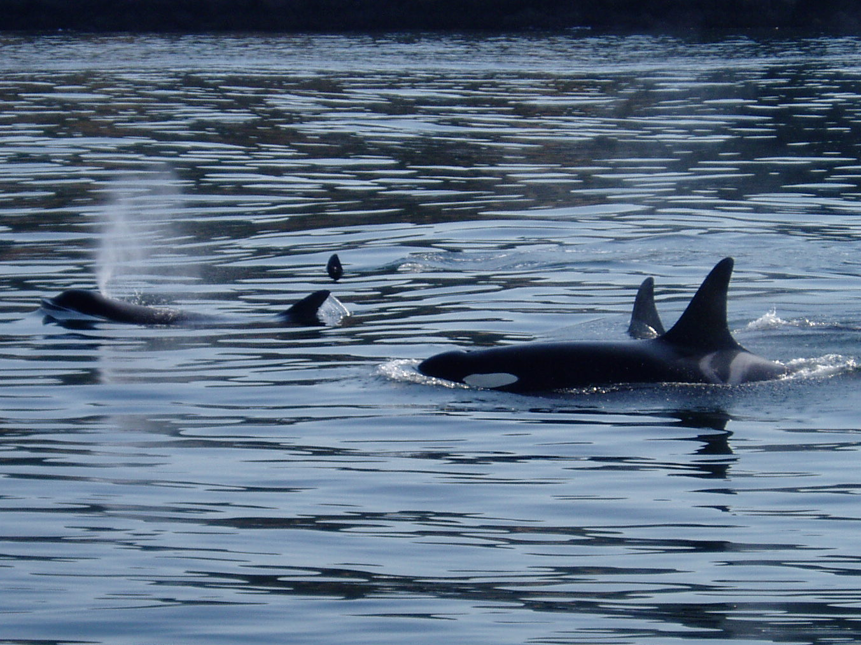
He is the image of the invisible God, the firstborn over all creation.

Slide 16
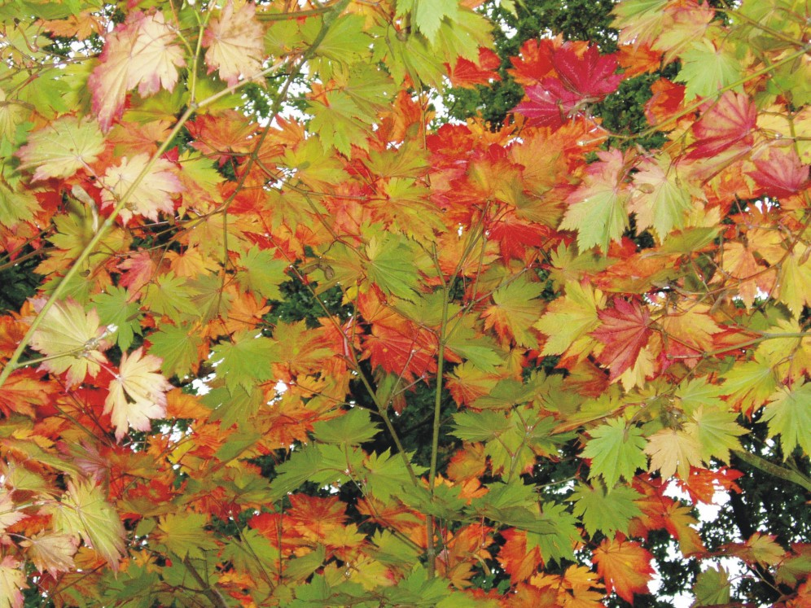
He is the image of the invisible God, the firstborn over all creation.

Slide 17
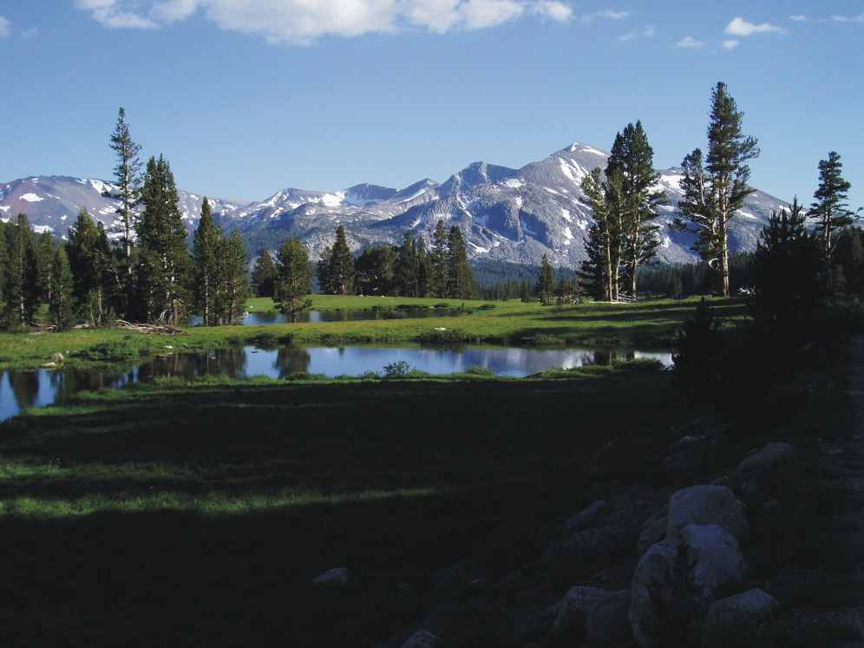
For by him all things were created: things in heaven and on earth, visible and invisible…

Slide 18
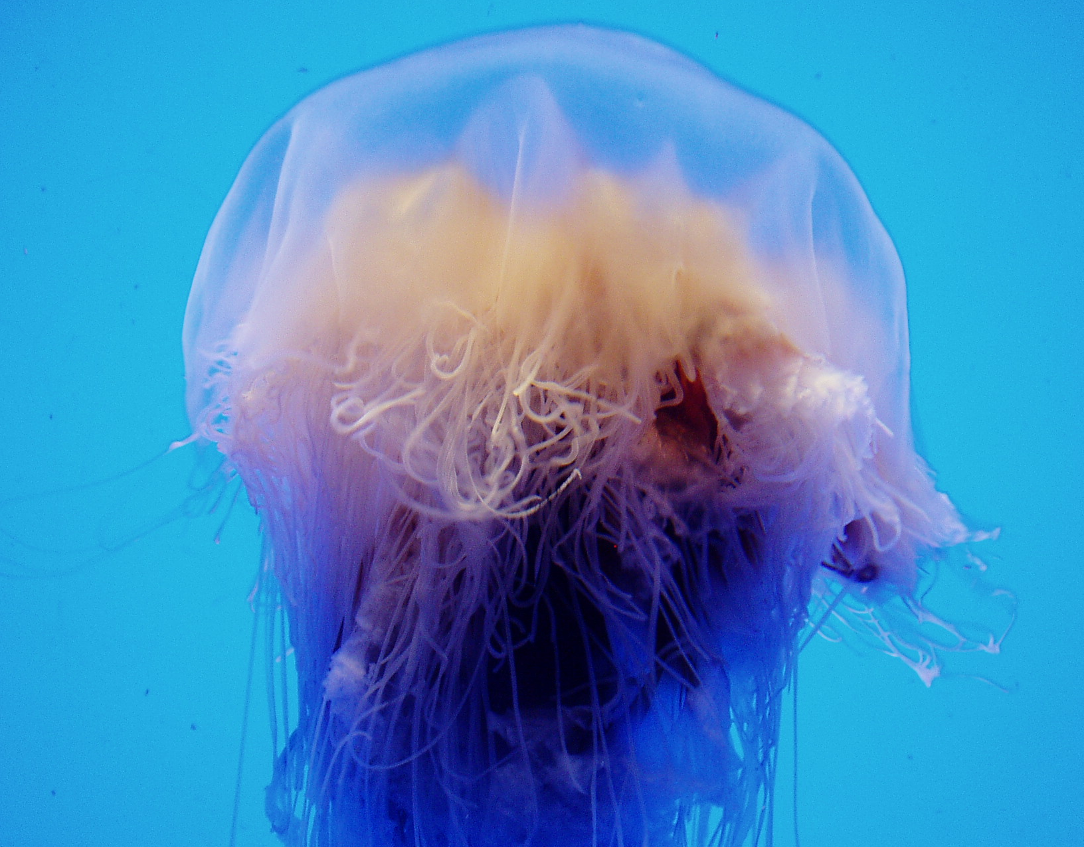
For by him all things were created: things in heaven and on earth, visible and invisible…

Slide 19
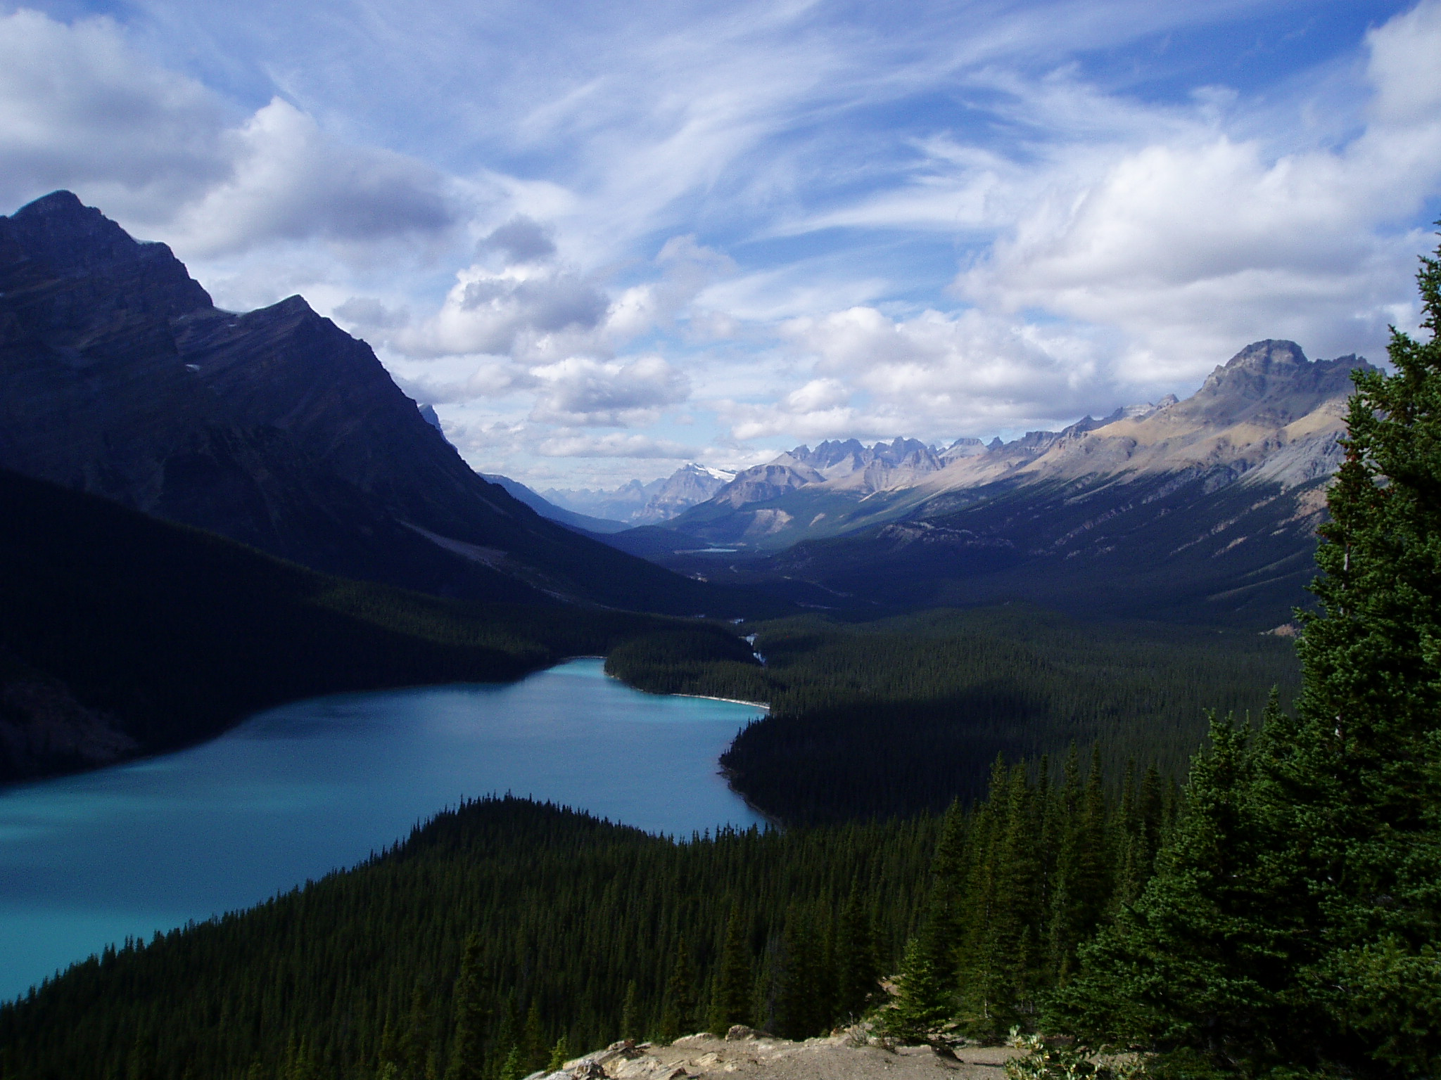
For by him all things were created: things in heaven and on earth, visible and invisible…

Slide 20
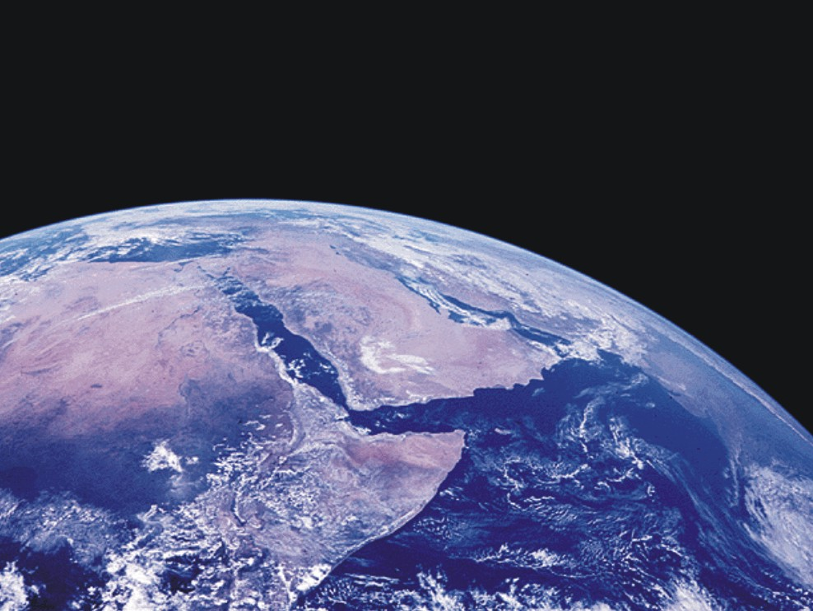
All things were created by him and for him.

Slide 21
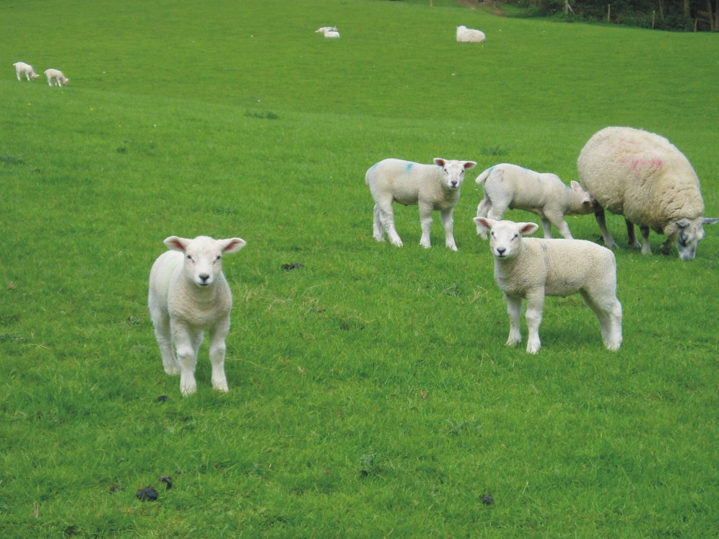
All things were created by him and for him.

Slide 22
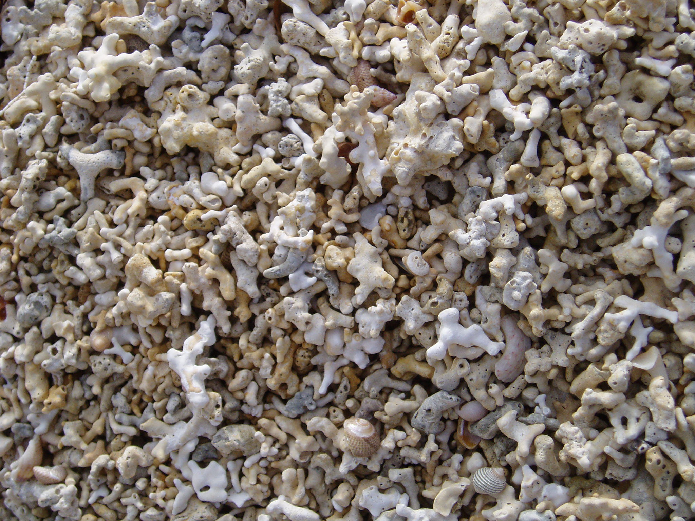
All things were created by him and for him.

Slide 23
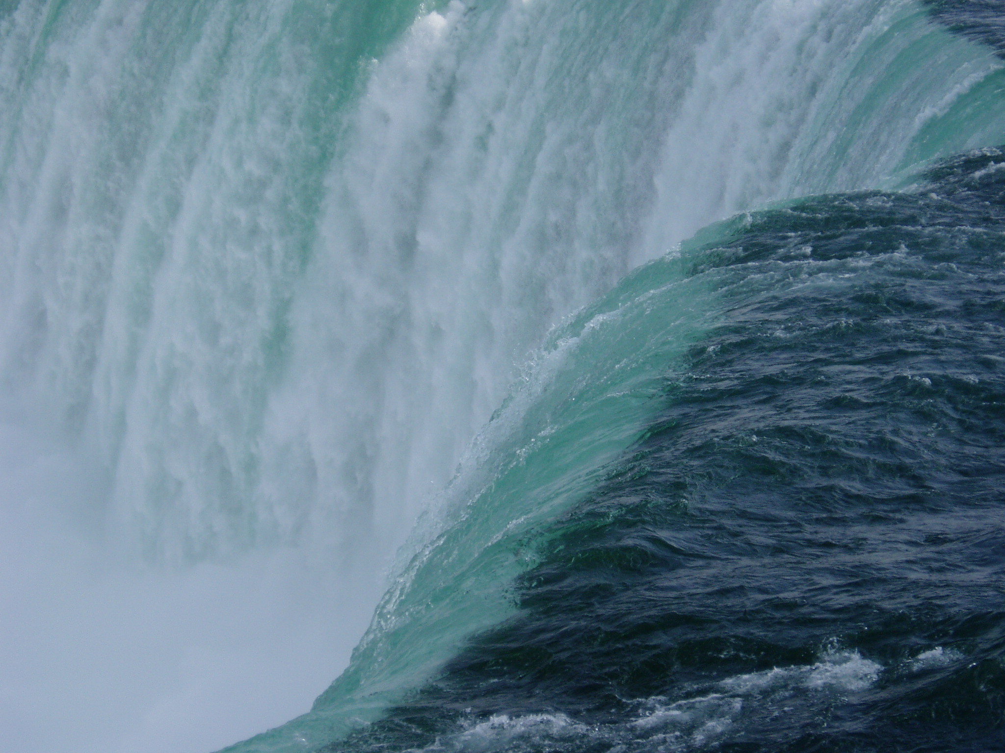
All things were created by him and for him.

Slide 24

And he is the head of the body, the church

Slide 25
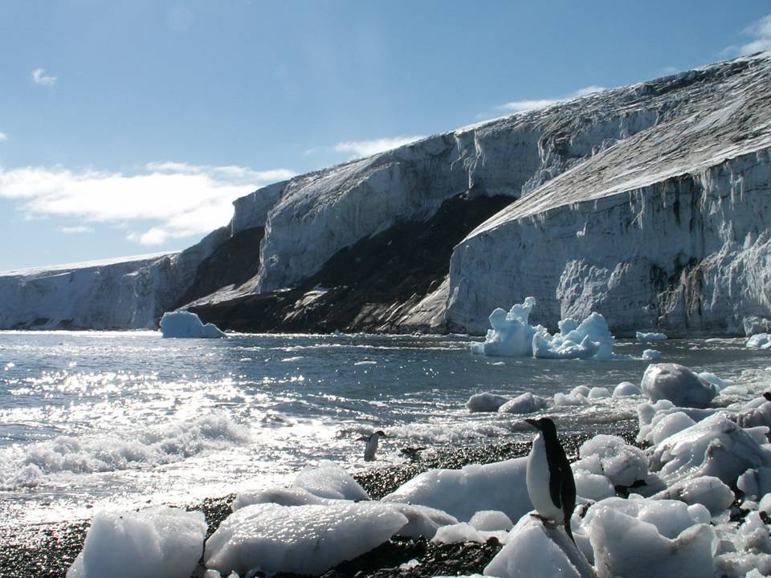
And he is the head of the body, the church

Slide 26
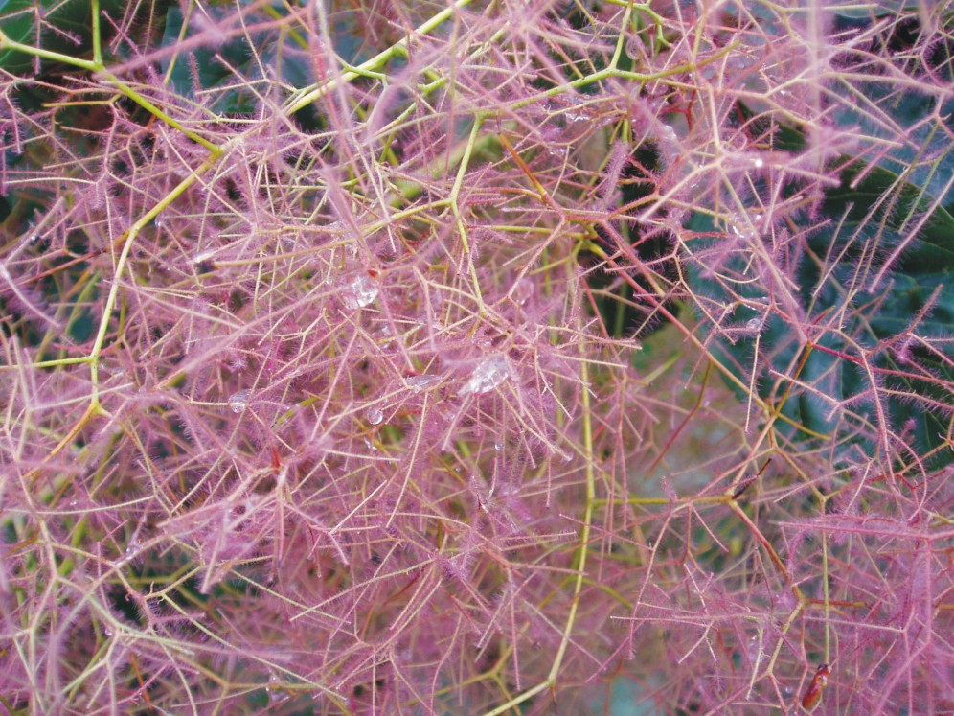
And he is the head of the body, the church

Slide 27
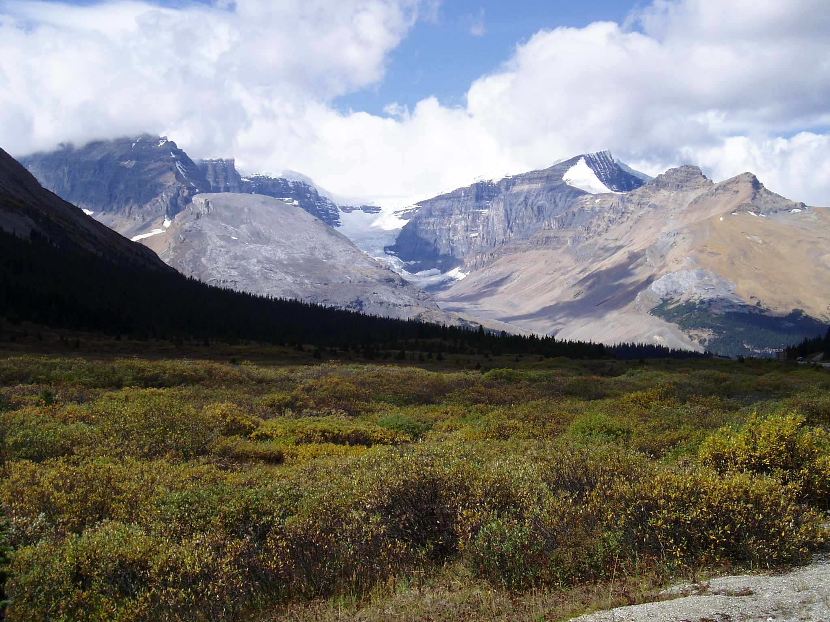
He is before all things,
and in him all things hold together

Slide 28
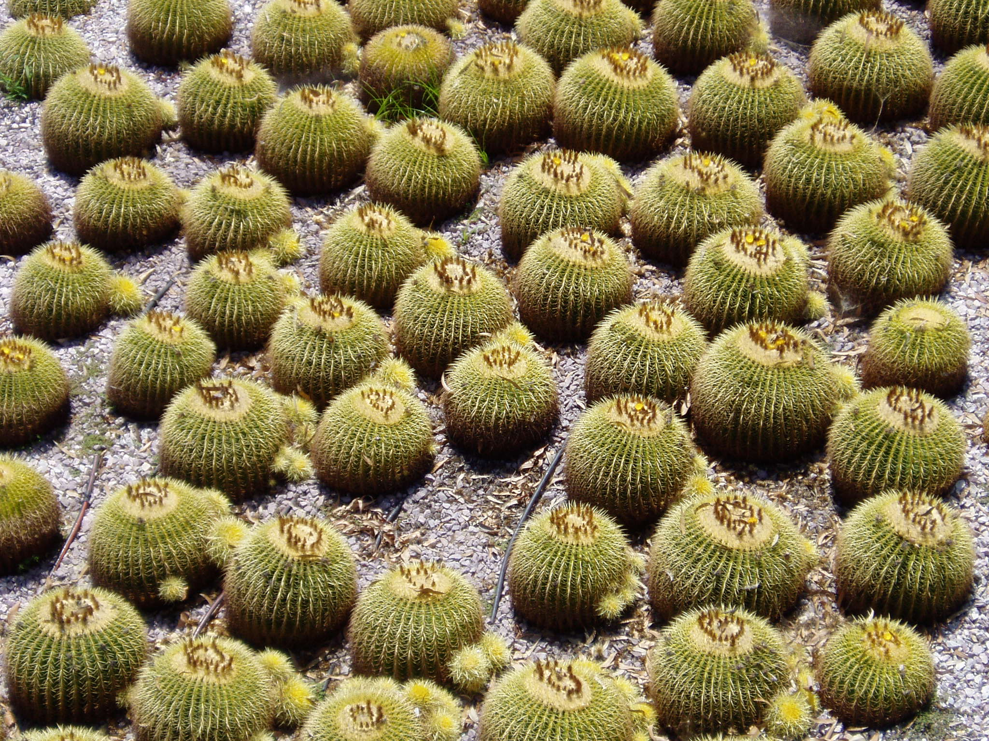
He is before all things,
and in him all things hold together

Slide 29
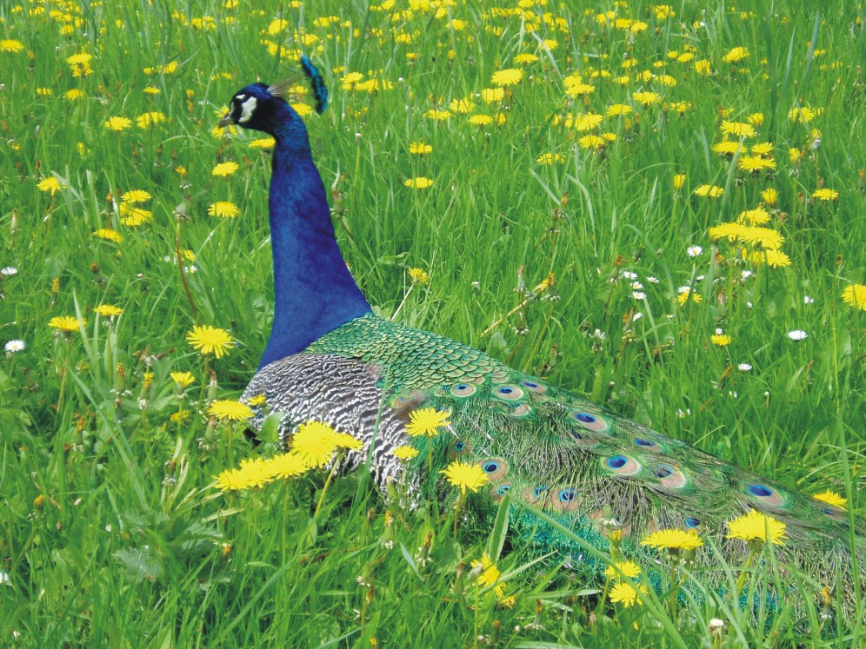
He is before all things,
and in him all things hold together

Slide 30
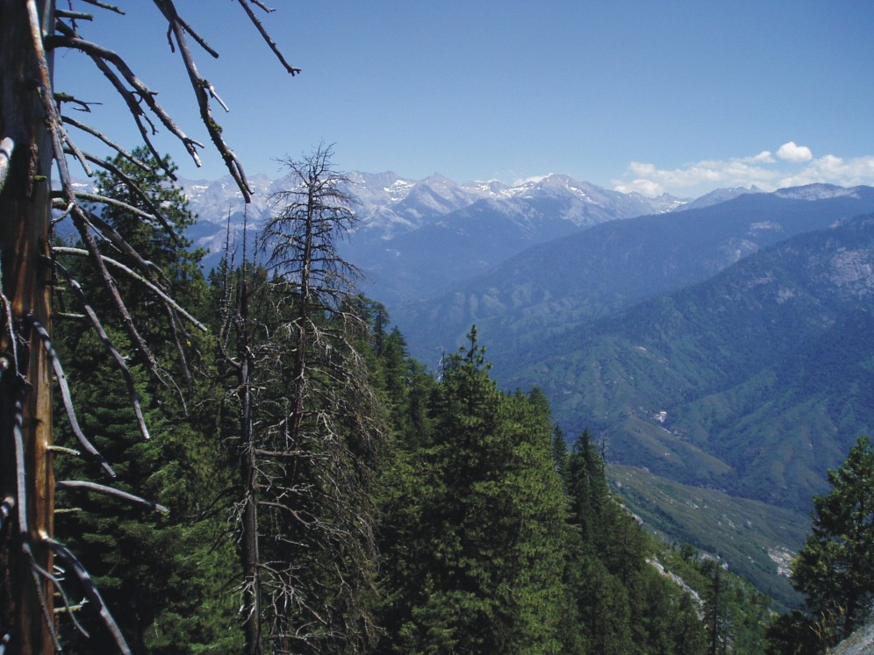
He is before all things,
and in him all things hold together

Slide 31

He is the beginning and the firstborn from among the dead, so that in everything he might have the supremacy.

Slide 32
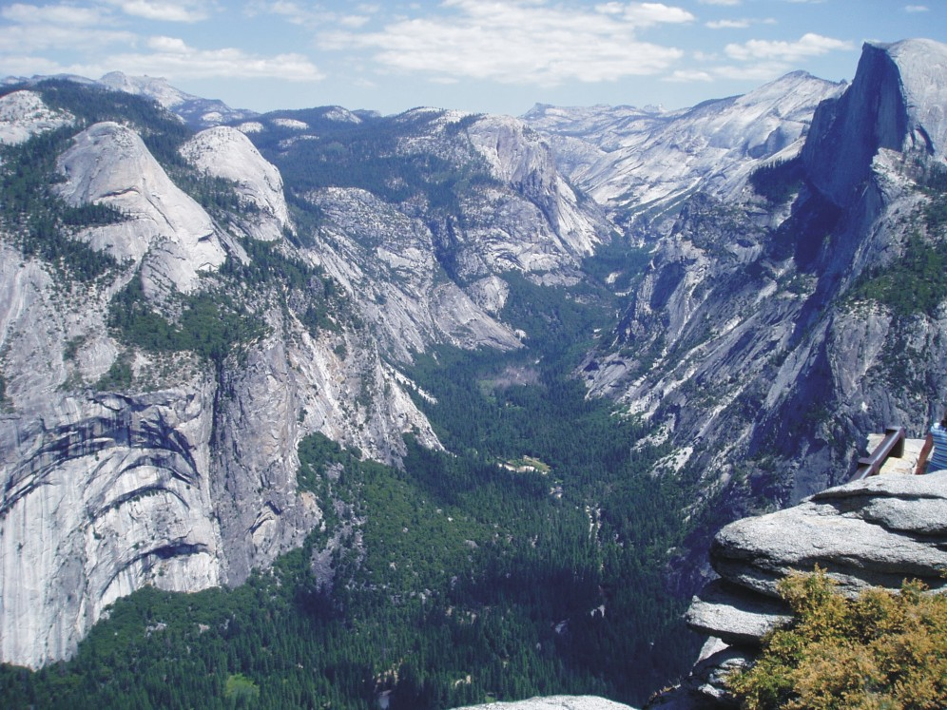
He is the beginning and the firstborn from among the dead, so that in everything he might have the supremacy.

Slide 33

He is the beginning and the firstborn from among the dead, so that in everything he might have the supremacy.

Slide 34

For God was pleased to have all his fullness dwell in him,

Slide 35
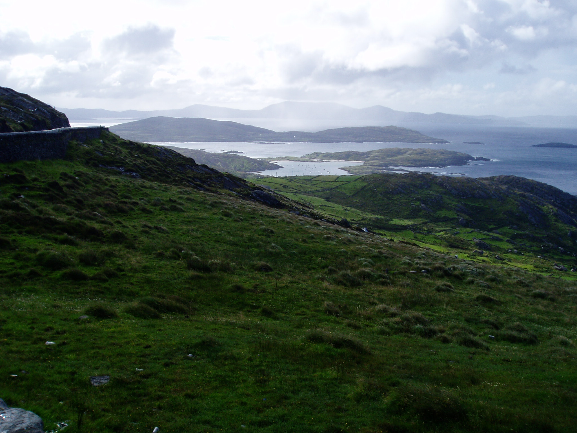
For God was pleased to have all his fullness dwell in him,

Slide 36
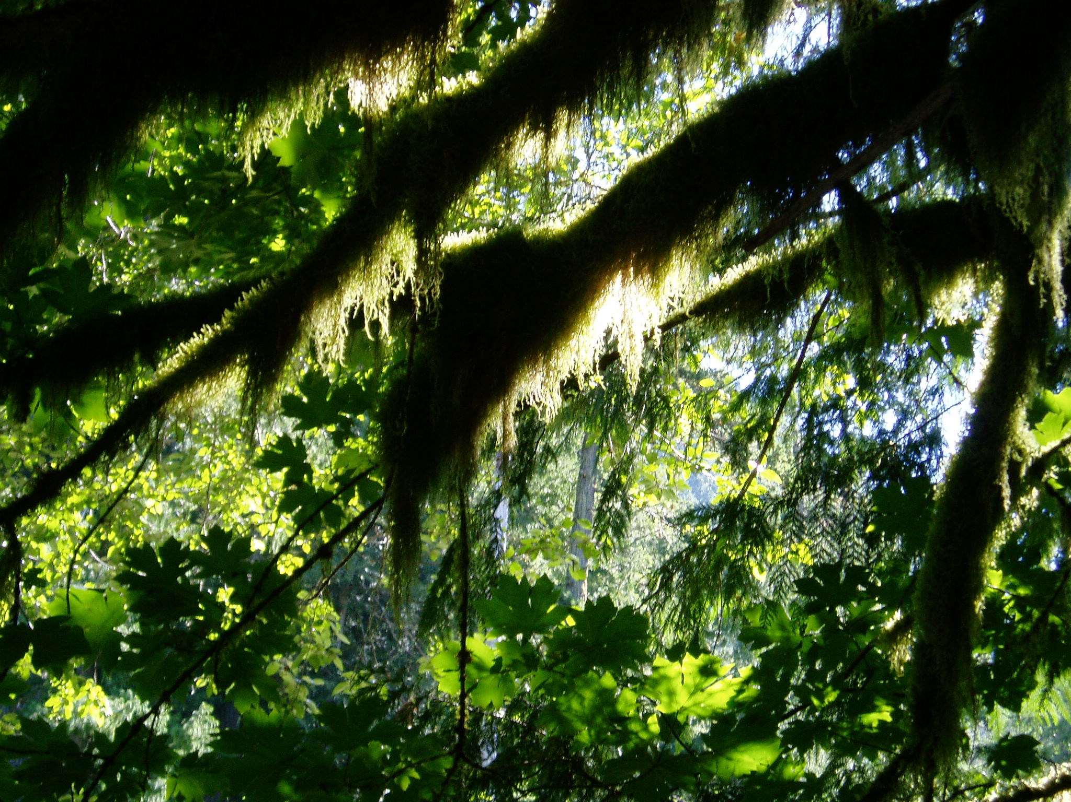
For God was pleased to have all his fullness dwell in him,

Slide 37
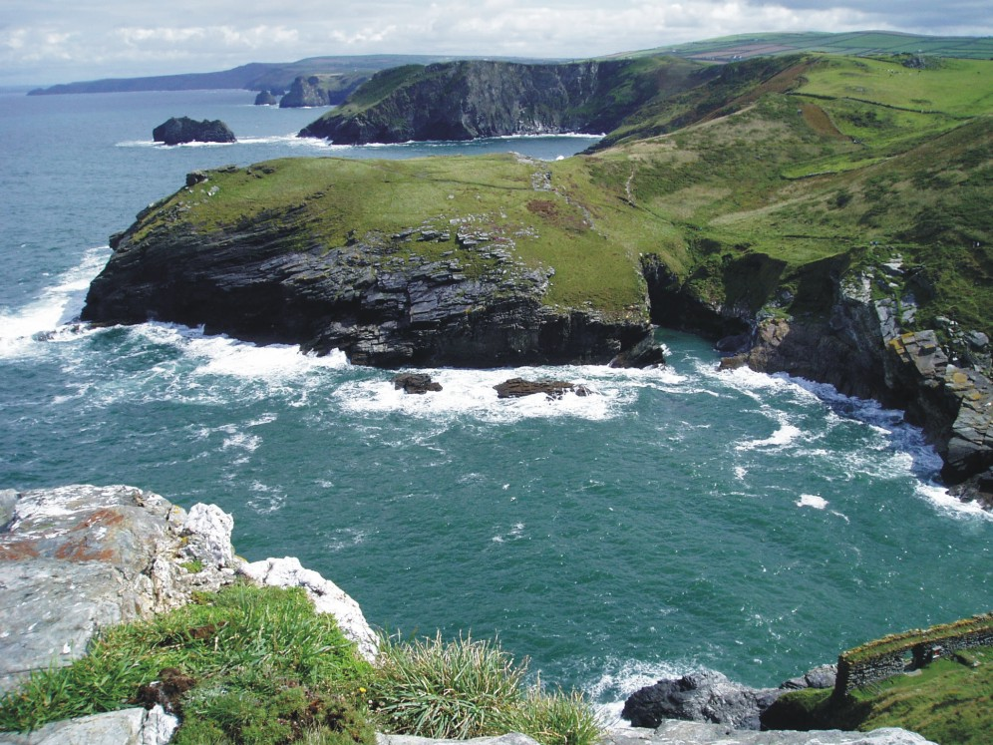
For God was pleased to have all his fullness dwell in him,

Slide 38
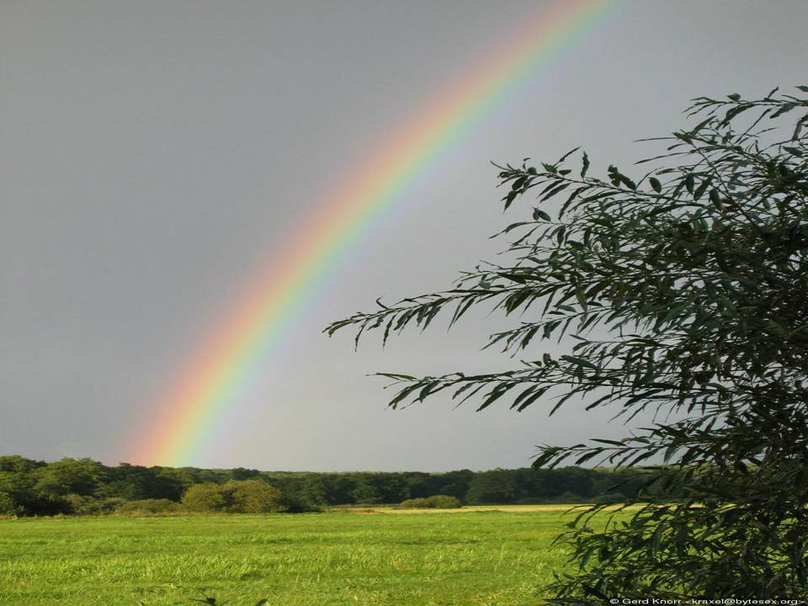
and through him to reconcile to himself all things, whether things on earth or things in heaven,

Slide 39
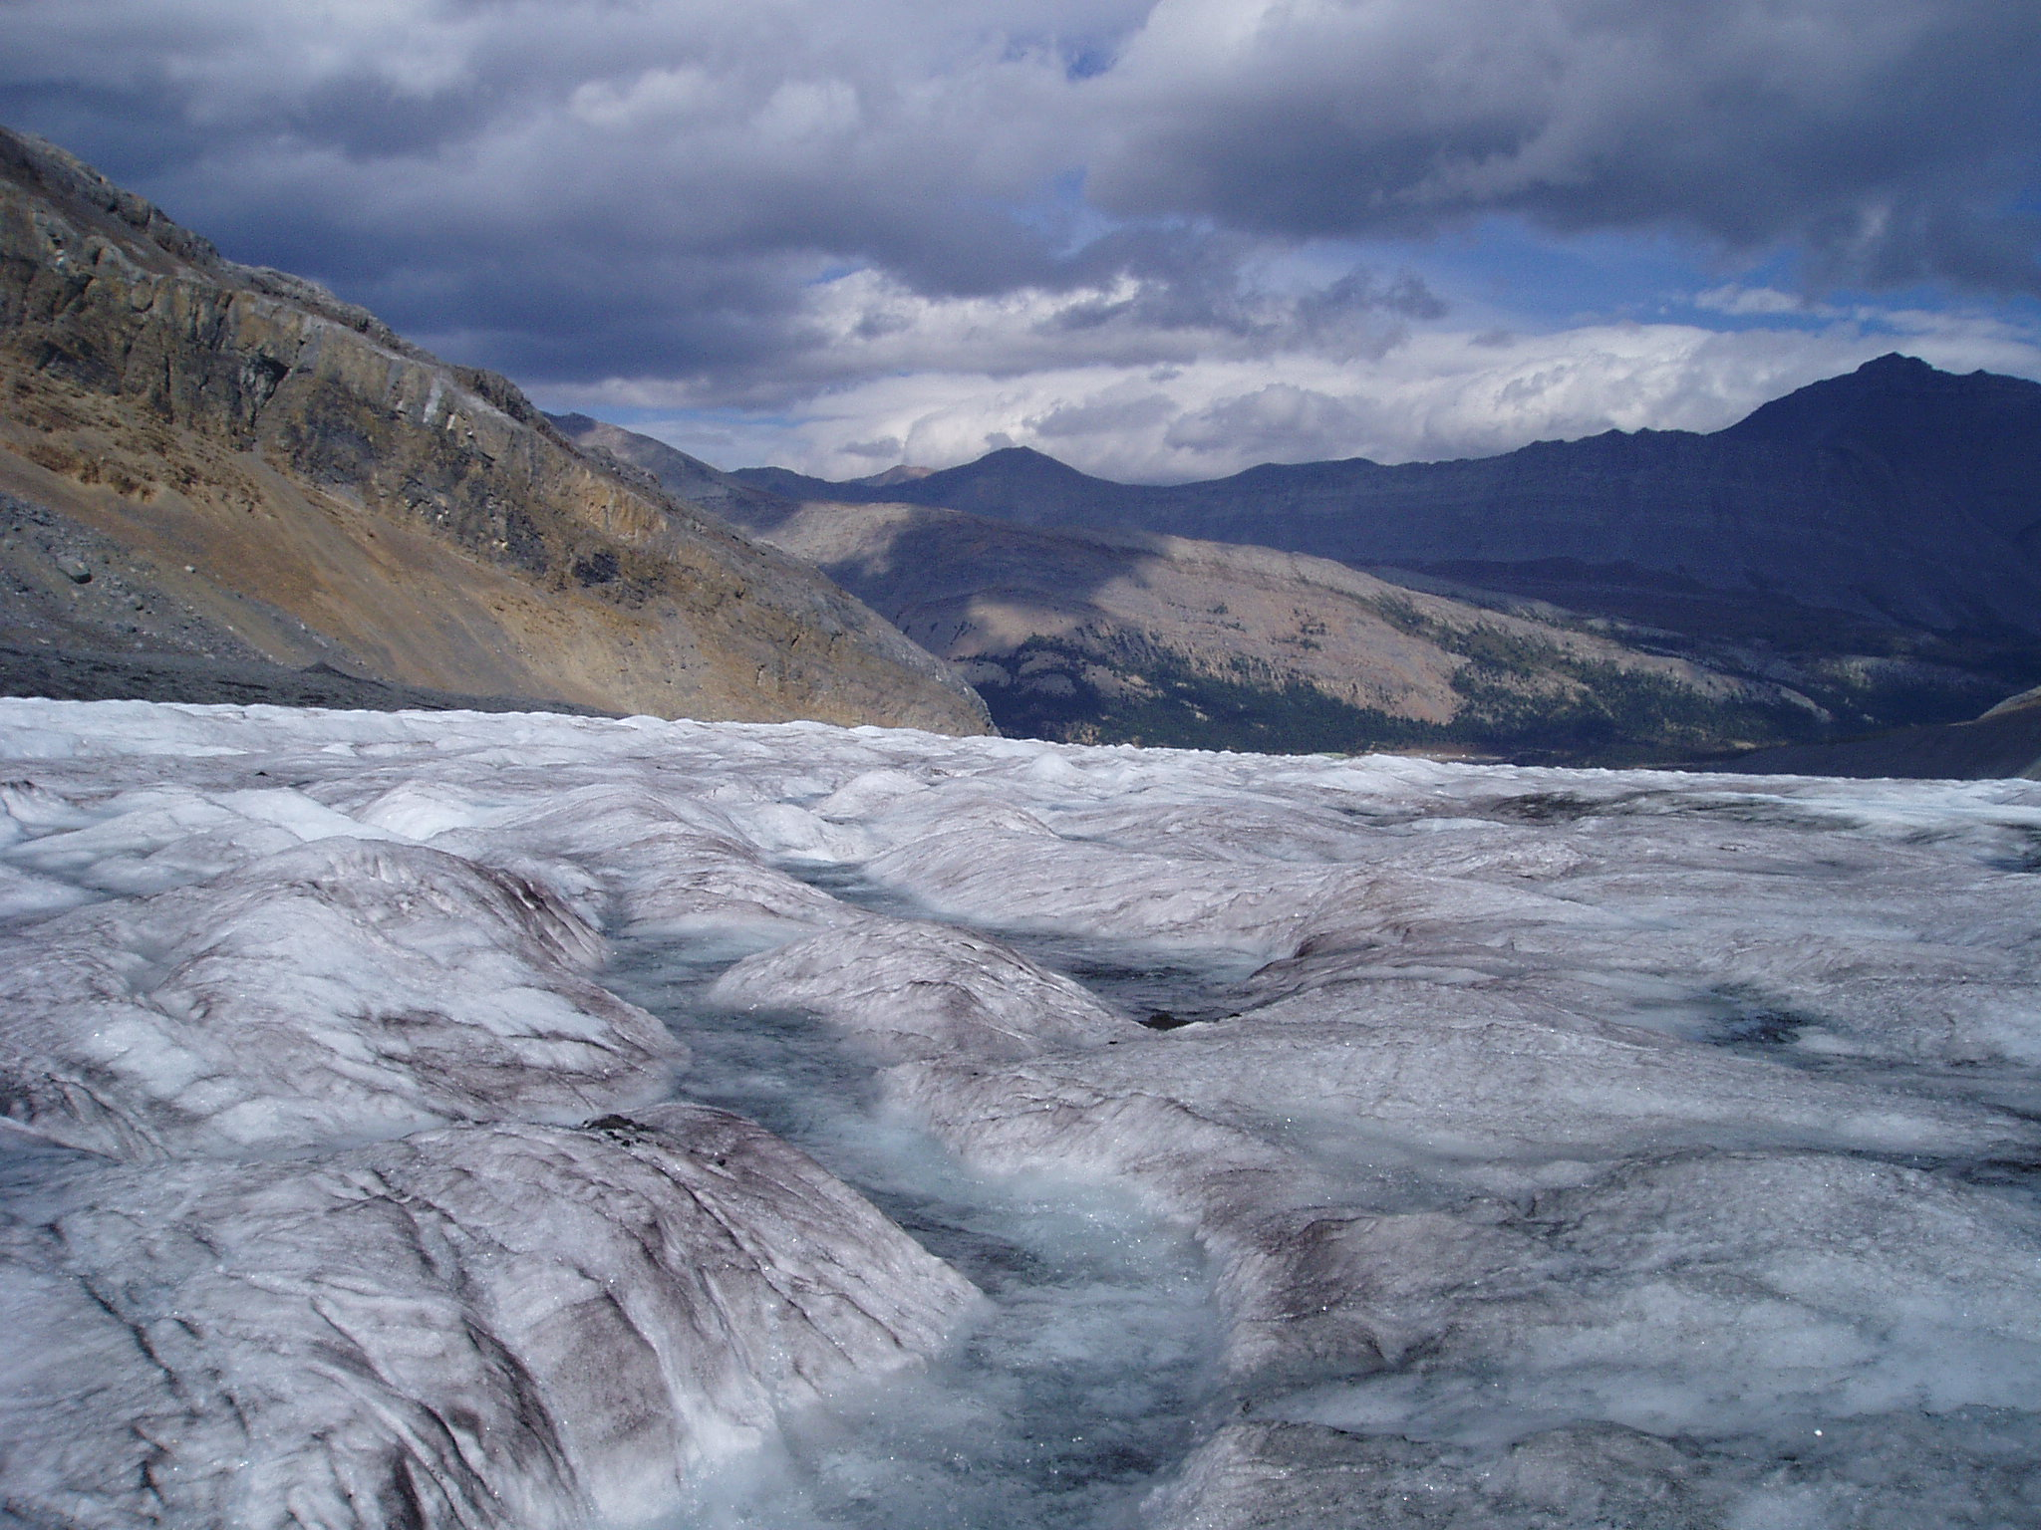
and through him to reconcile to himself all things, whether things on earth or things in heaven,

Slide 40
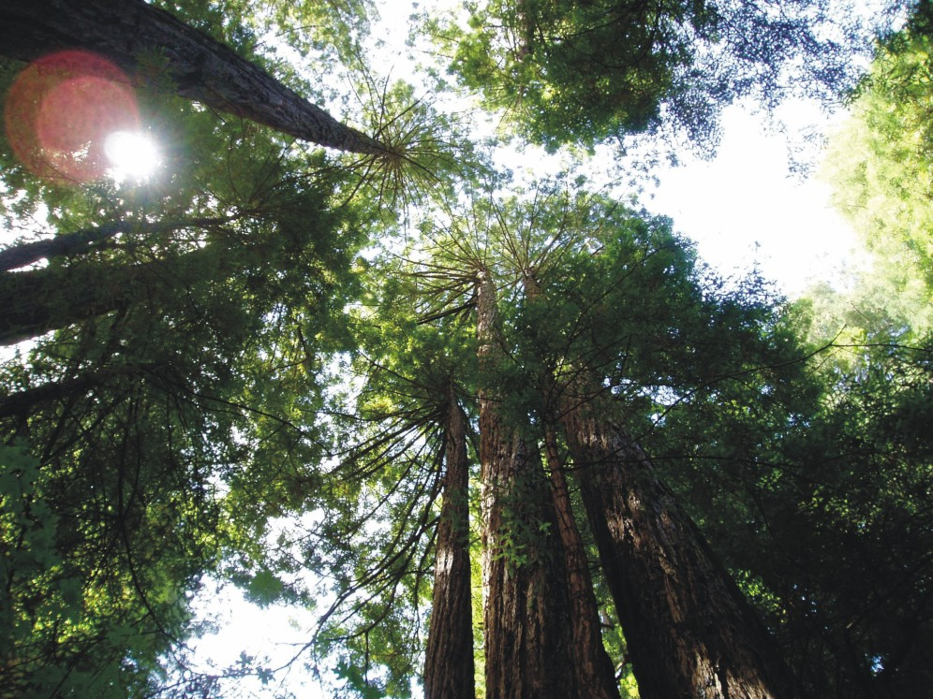
and through him to reconcile to himself all things, whether things on earth or things in heaven,

Slide 41
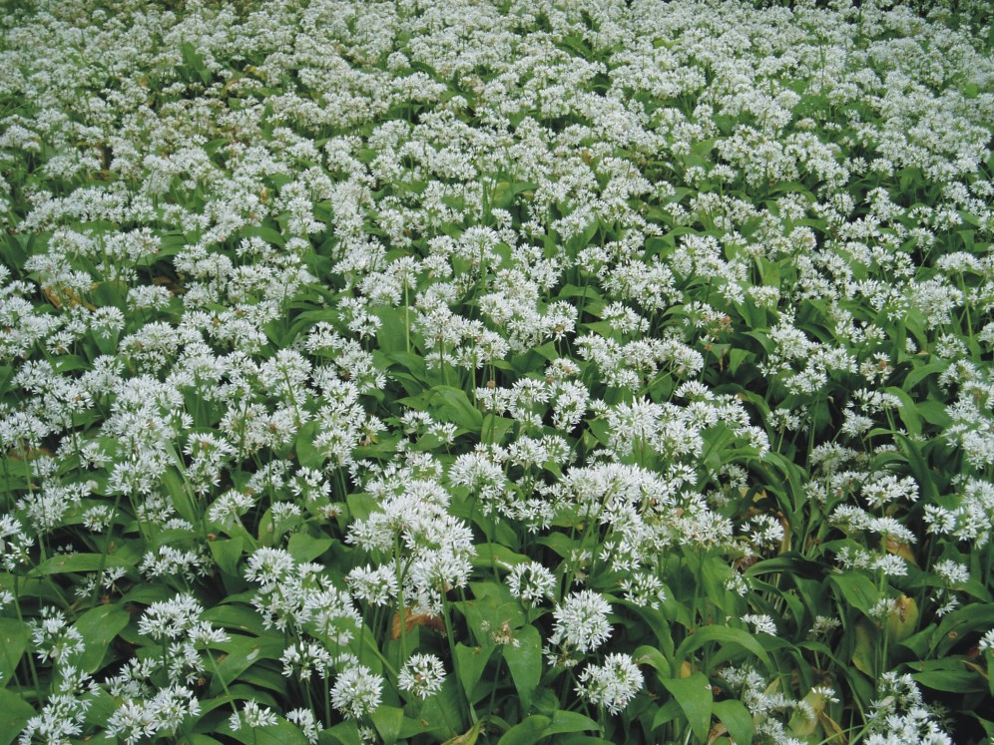
by making peace through his blood, shed on the cross.

Slide 42
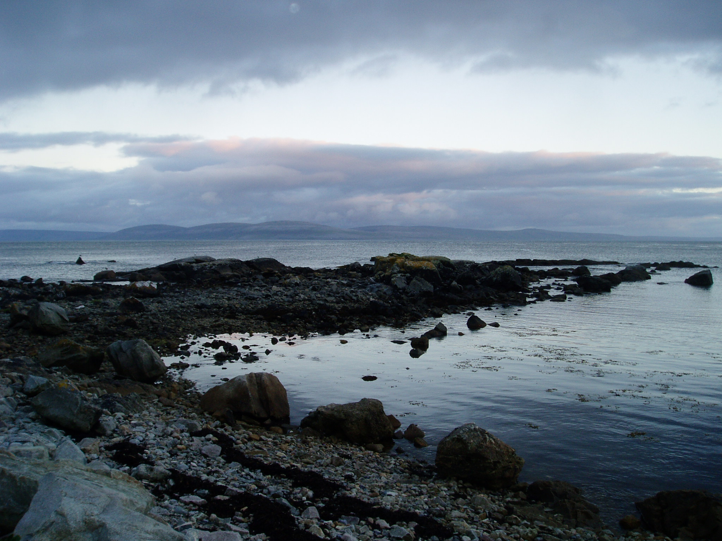
by making peace through his blood, shed on the cross.

Slide 43

by making peace through his blood, shed on the cross.

Slide 44
Dr Ruth Valerio
A Rocha UK
Tools for Transformation : :

Slide 45
Why should we care for God’s creation?
For the sake of the Earth
For the sake of the poor
For the sake of ourselves
For the sake of God
Tools for Transformation : :

Slide 46


Everything You Need
To Know…

Slide 47


Slide 48

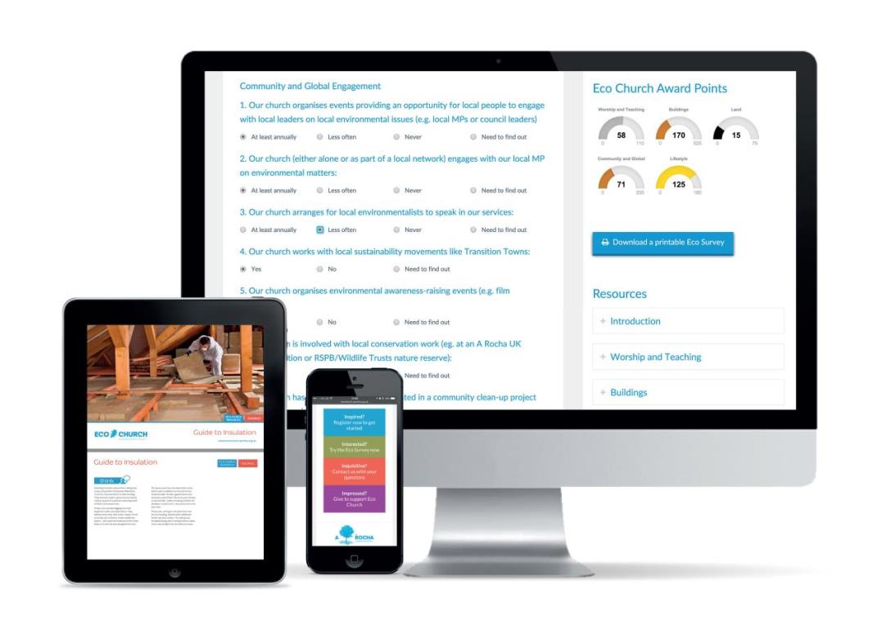

Slide 49






Slide 50
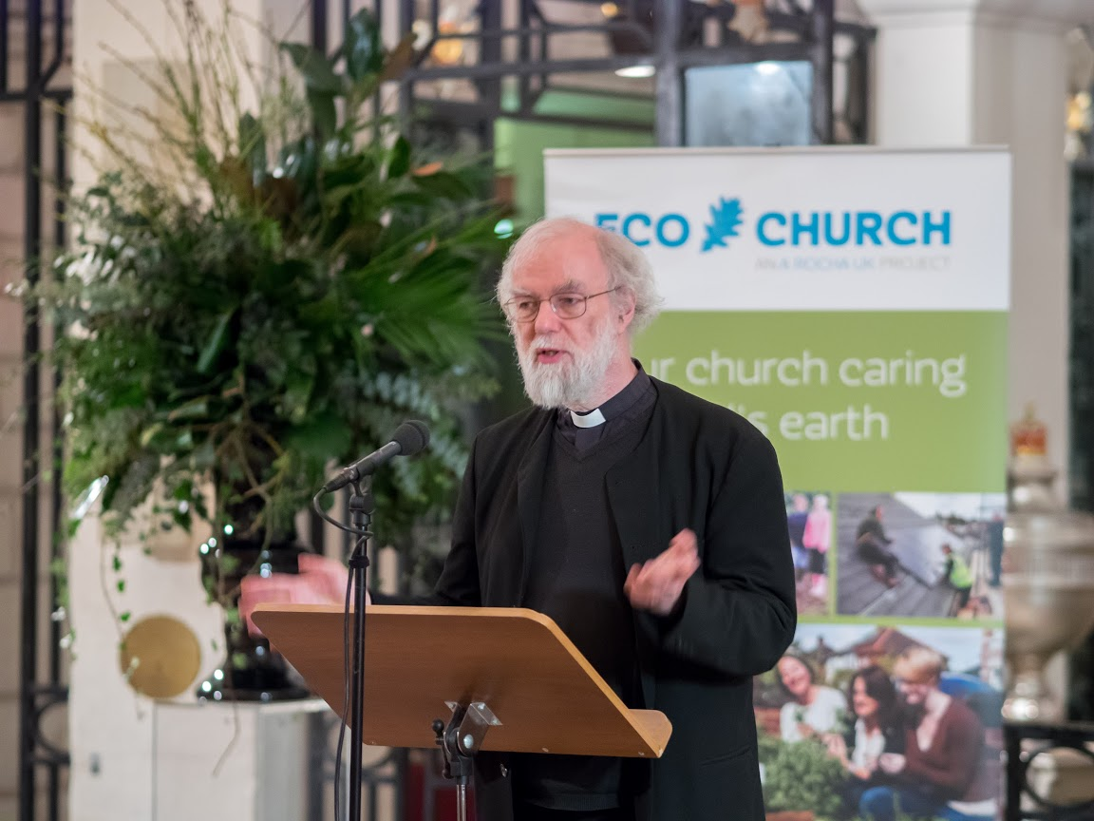

Slide 51
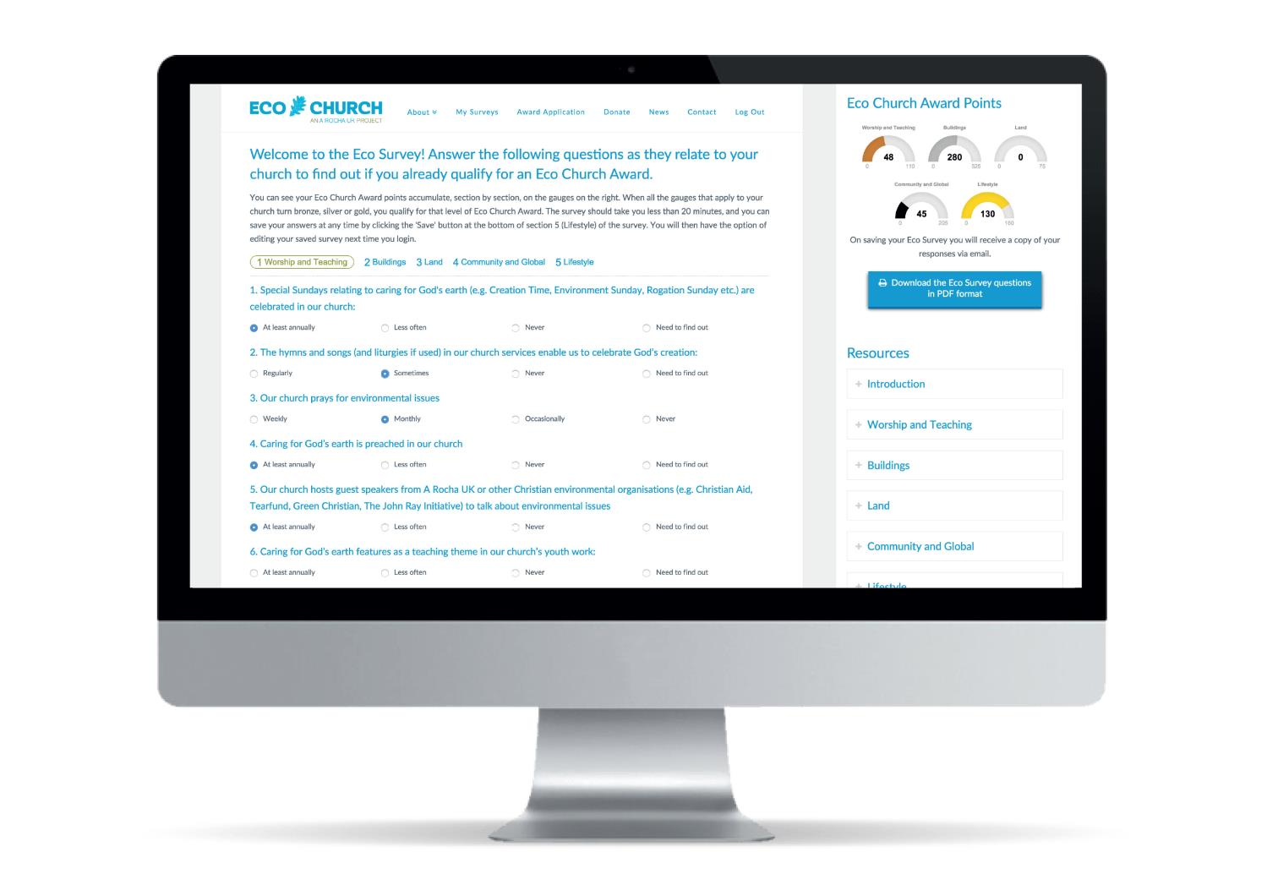
www.ecochurch.arocha.org.uk

Slide 52
Eco Survey
Worship and teaching
Management of church buildings
Management of church land
Community and global engagement
Lifestyle

Slide 53
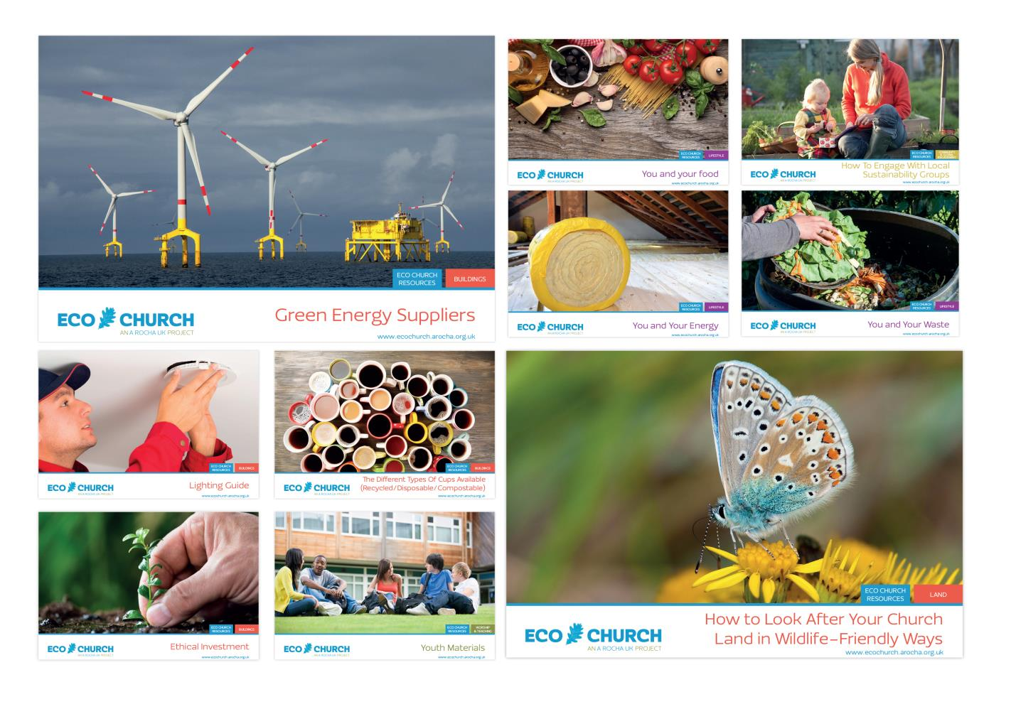

Slide 54
www.ecochurch.arocha.org.uk

Slide 55
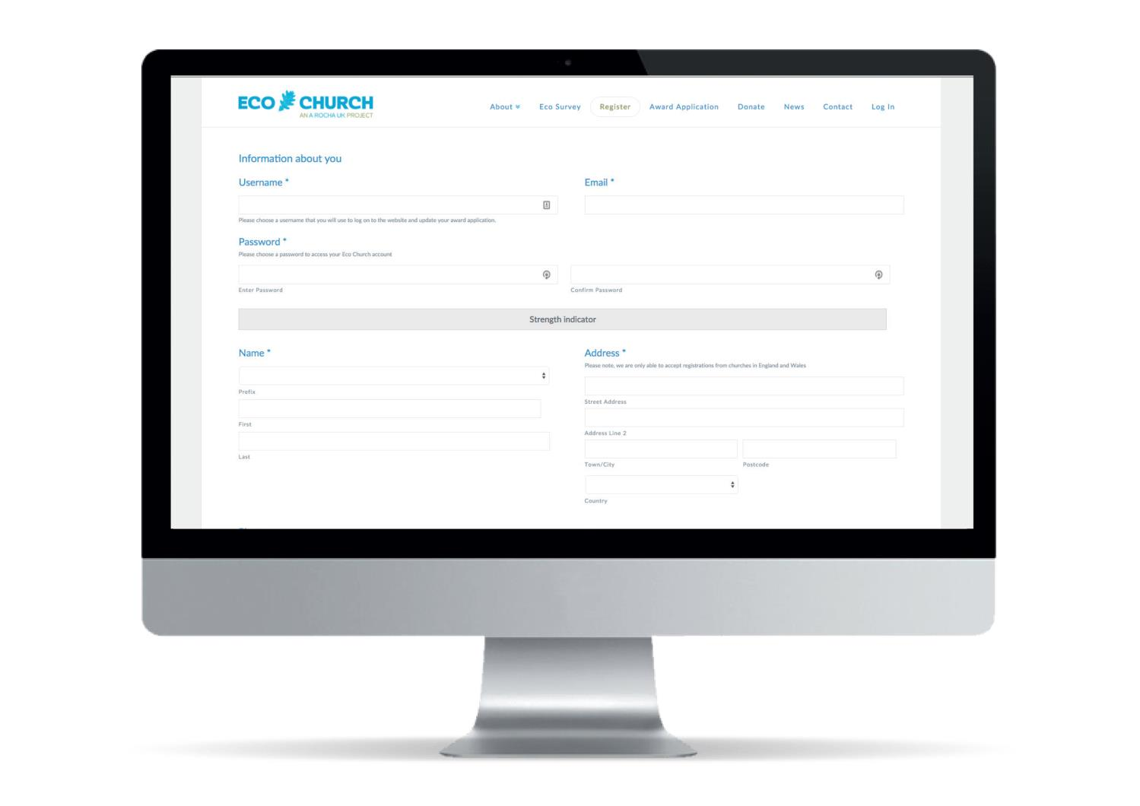
www.ecochurch.arocha.org.uk

Slide 56
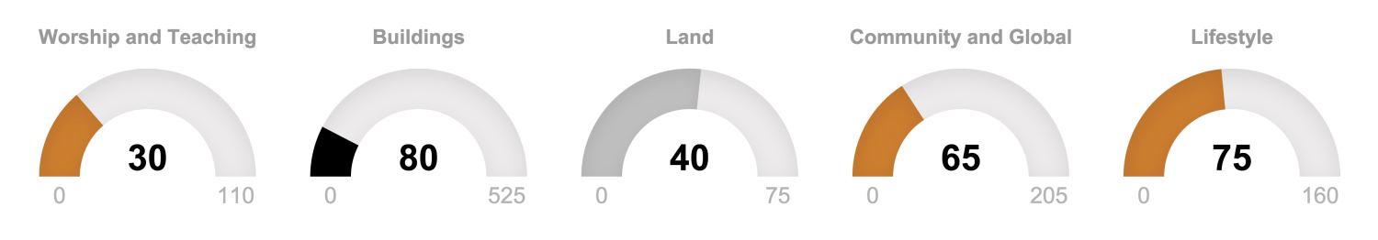
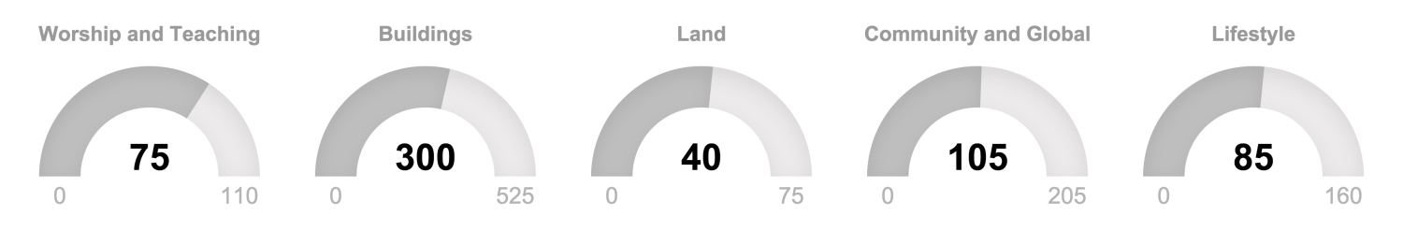
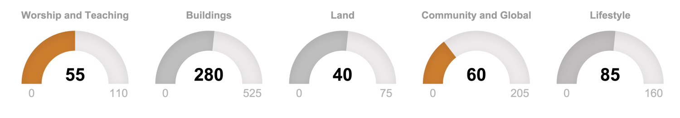
Eco Church Award Points

Slide 57
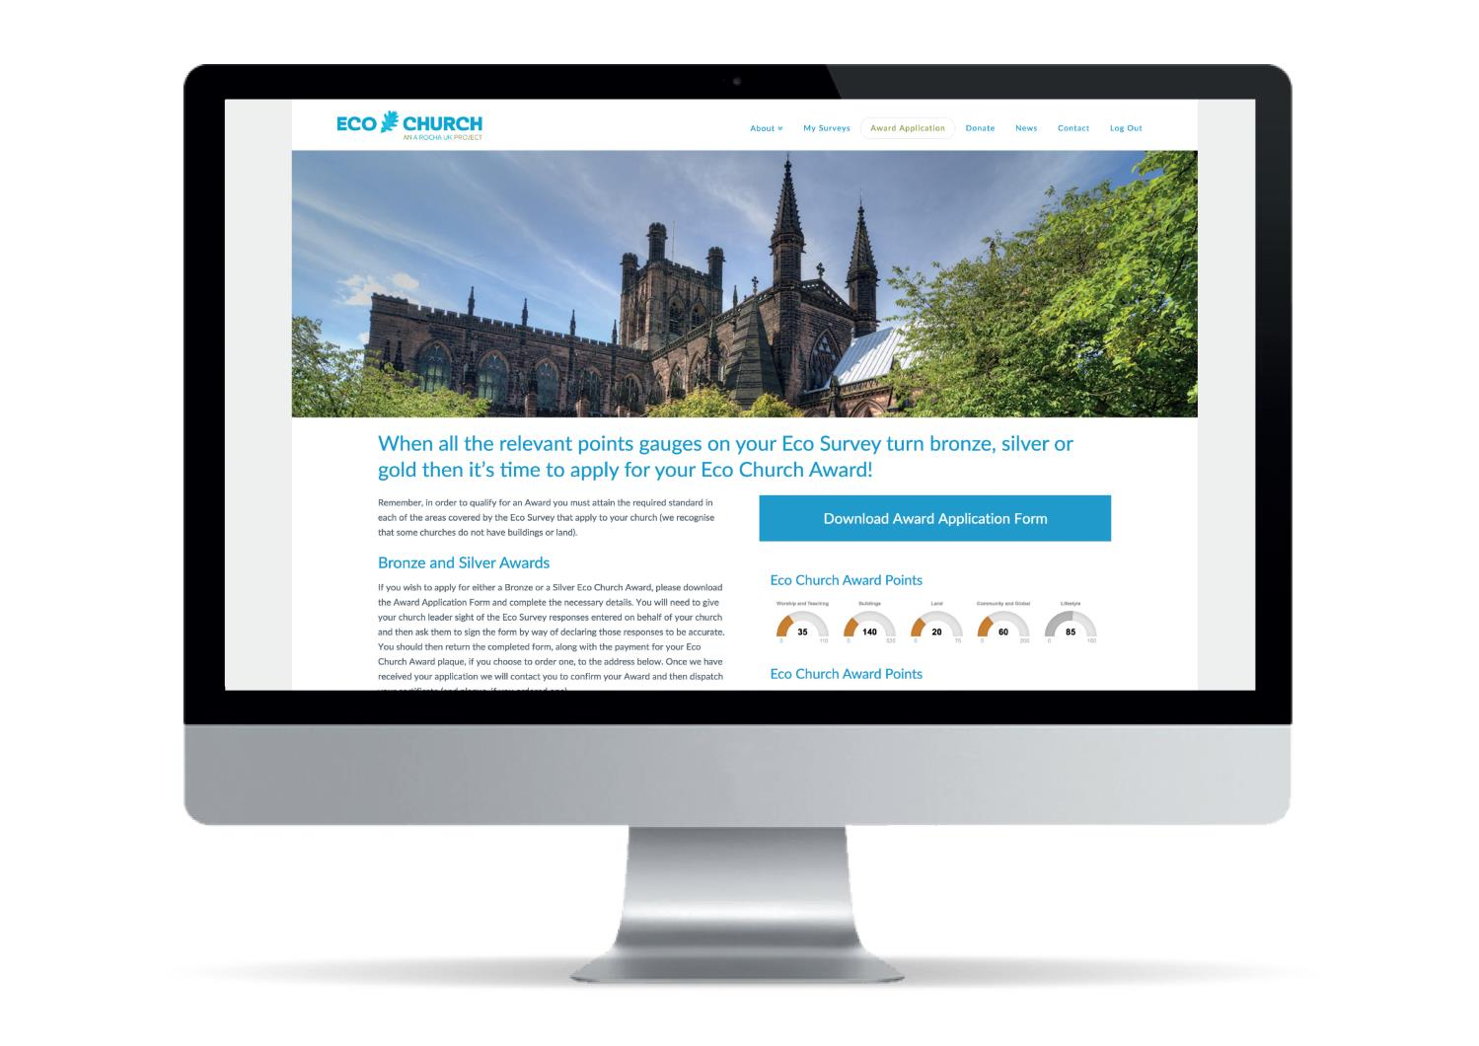
www.ecochurch.arocha.org.uk

Slide 58


Slide 59
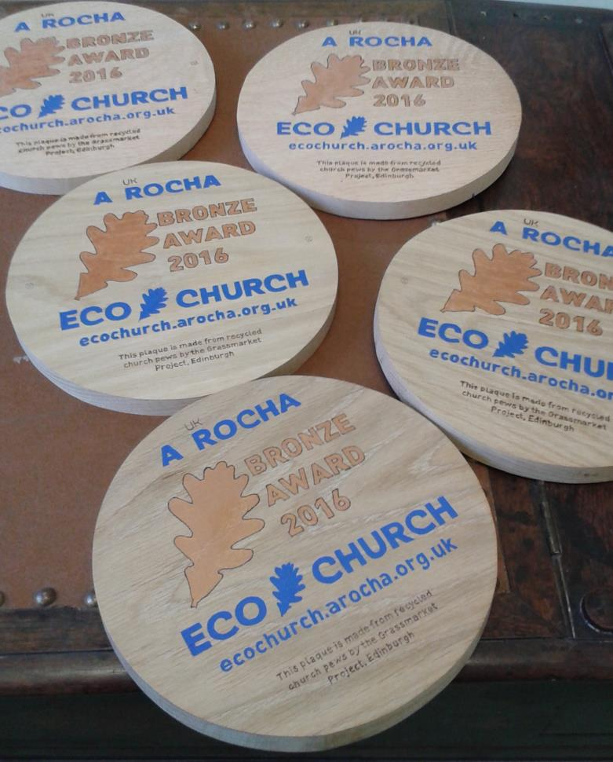

Slide 60
Register at:
www.ecochurch.arocha.org.uk

Slide 61
Charlotte Scott
Christian Aid
Tools for Transformation : :

Slide 62


Tools for [Global] Transformation
Simple and practical ways for your church to care for God’s earth

Slide 63
Tools for [Global] Transformation
Simple and practical ways for your church to care for God’s earth

Slide 64

https://www.bigchurchswitch.org.uk/
Tools for Transformation

Slide 65
Sharing Stories
What Churches are doing
Tools for Transformation : :

Slide 66

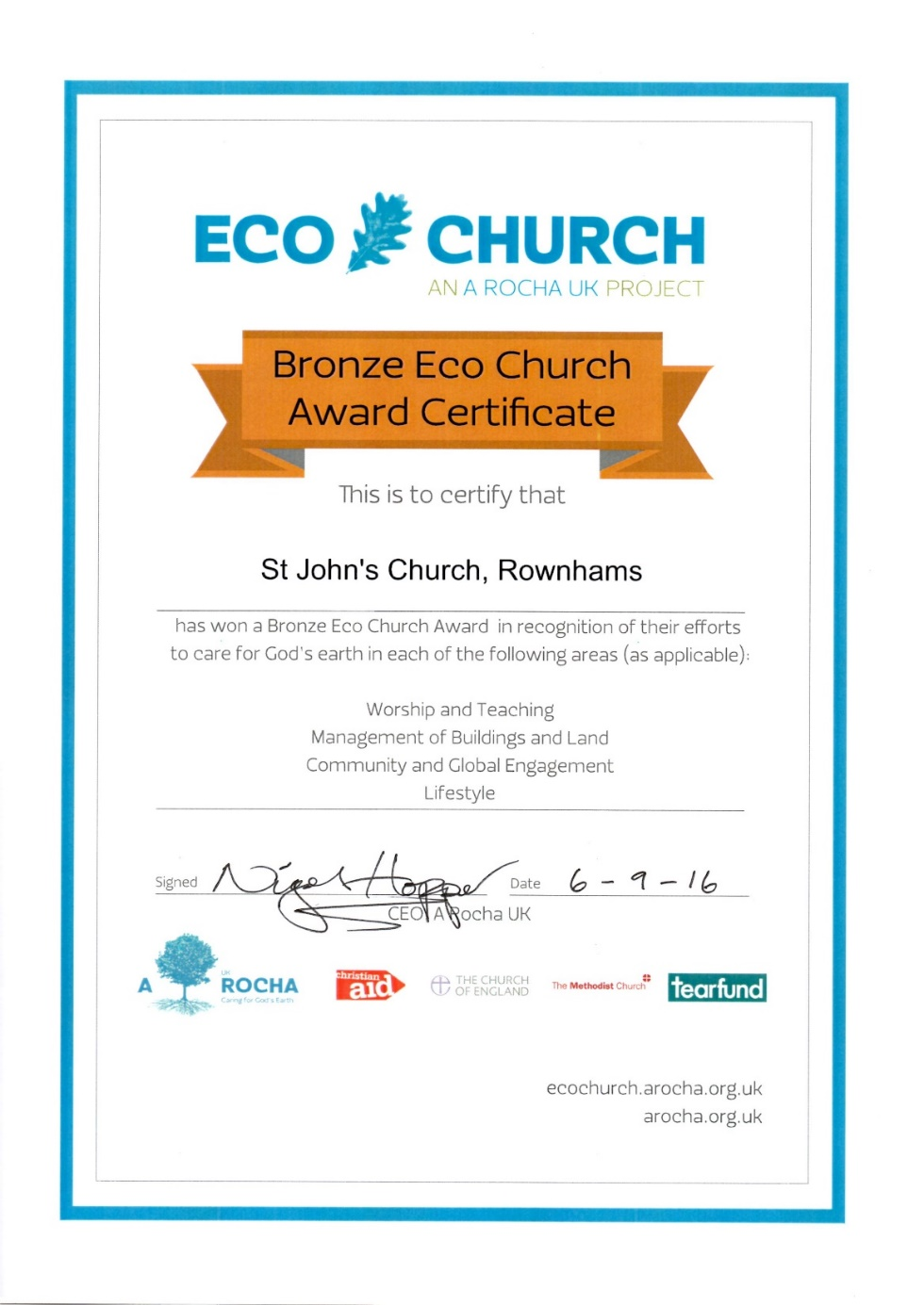

Slide 67
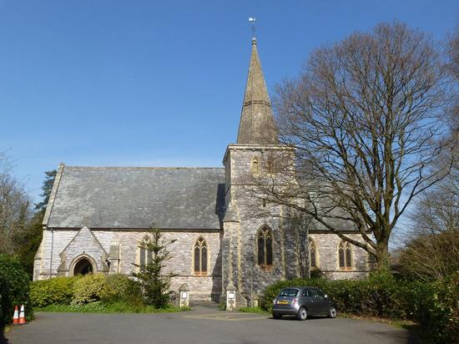
Beautiful But Challenging Victorian Building

Slide 68
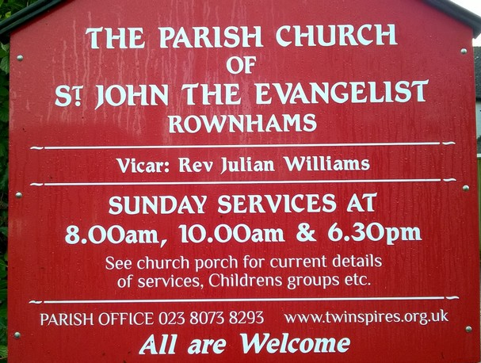
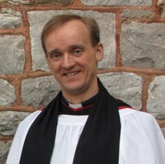
Very Helpful to Have Your Vicar On Board

Slide 69
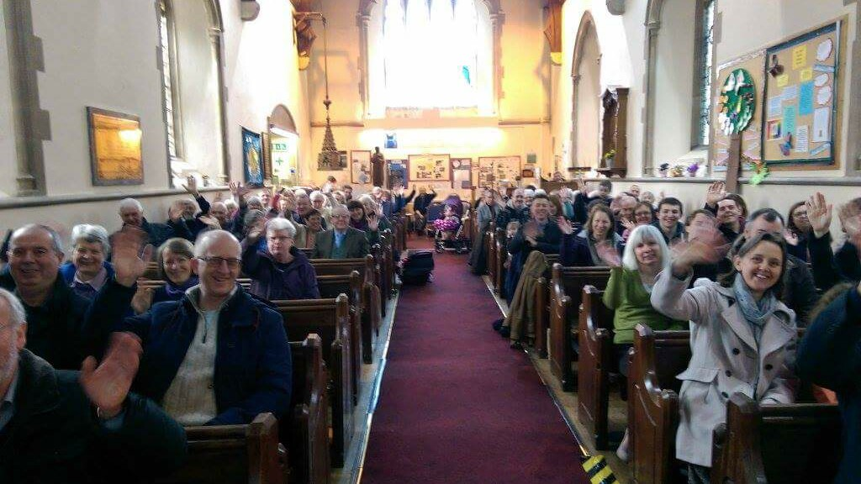
Our Church Family

Slide 70
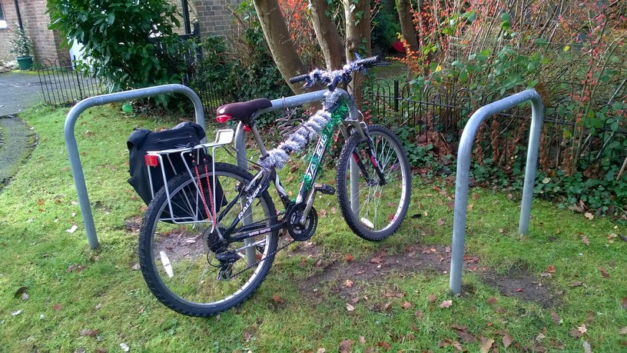
Cycle Racks
Saving on Carbon Emissions

Slide 71
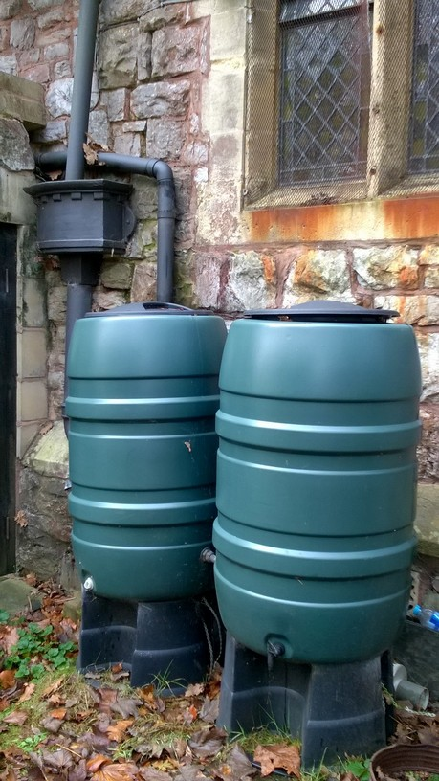
Water Butts

Slide 72
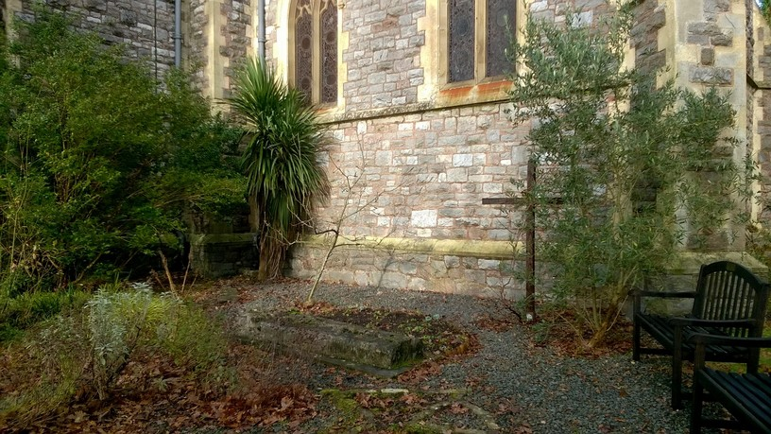
Bible Garden

Slide 73
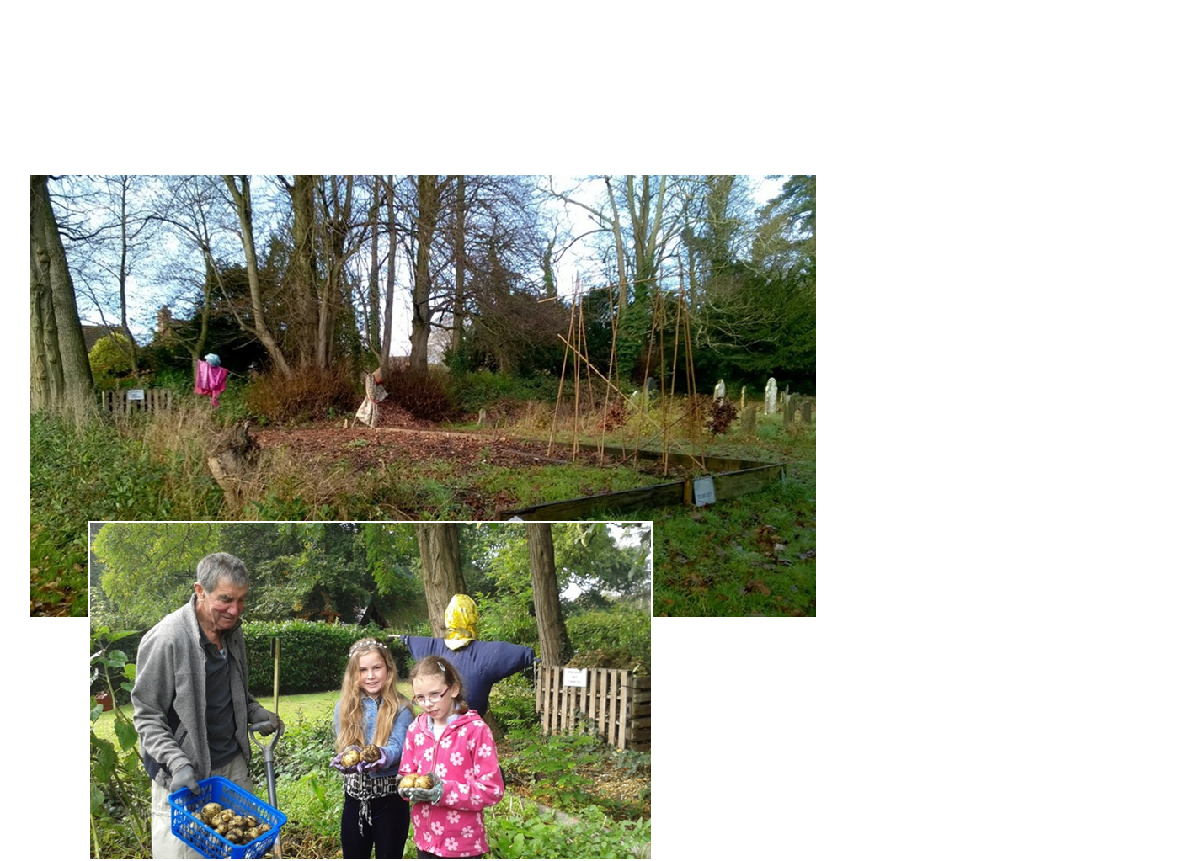

Slide 74
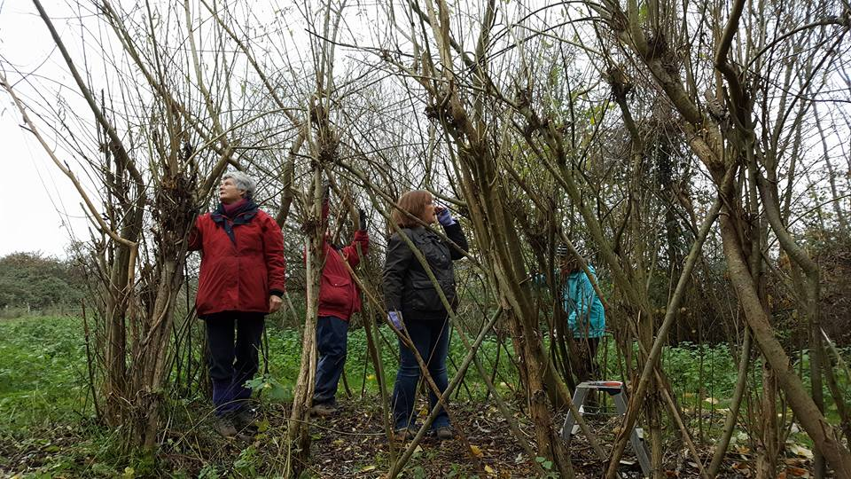
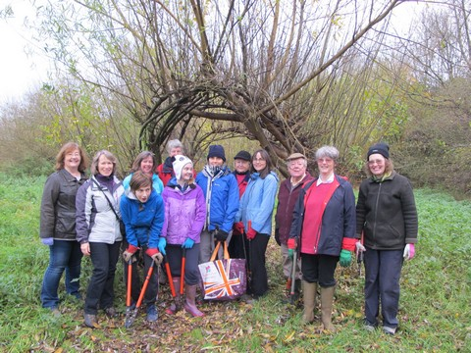
Testwood Lakes
Involvement with Local Conservation Work

Slide 75
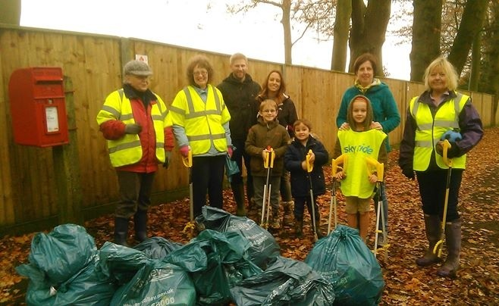
Litter Pick
Tidying, Engaging with Community, Recycling

Slide 76
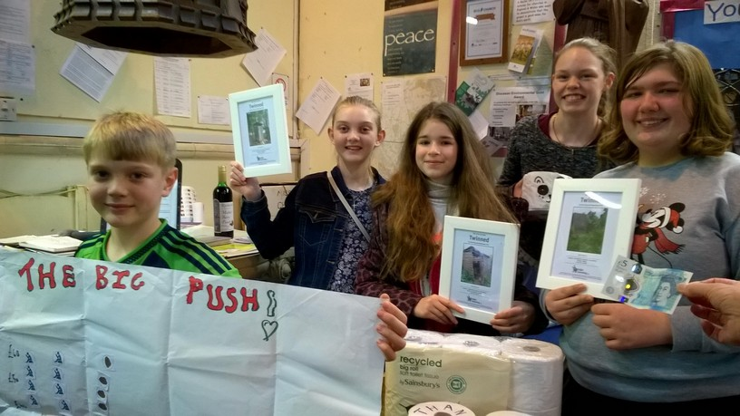
Toilet Twinning
7 Communities Now Have Improved Hygiene

Slide 77
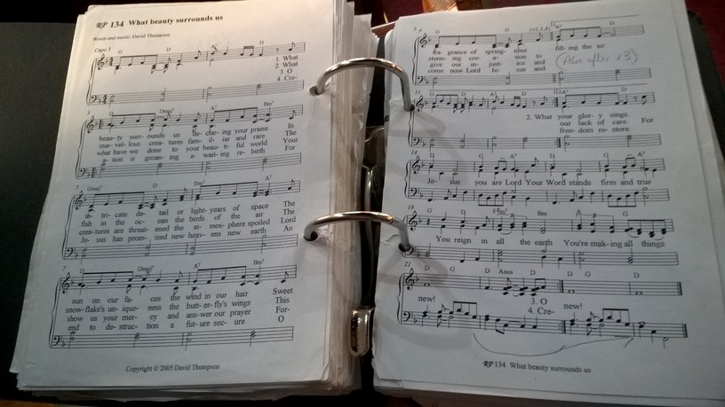

Celebrating God’s Creation

Slide 78

Christmas Card
Saving Paper and Donation to Charity

Slide 79


Green Tips
Spreading Ideas and Encouragement

Slide 80

Fair Trade
Tea and Coffee Always Served at Morning Service

Slide 82
Sharing Stories
What Churches are doing
Tools for Transformation : :

Slide 83
Tools for Transformation
Simple and practical ways for your church to care for God’s earth

Slide 84
FRANCISCAN BLESSING
May God bless us with a restless discomfort about easy answers, half-truths, and superficial relationships, so that we may seek truth boldly and love deep within our hearts.
May God bless us with holy anger at injustice, oppression, and exploitation of people, so that we may tirelessly work for justice, freedom, and peace among all people.
Tools for Transformation : :

Slide 85
May God bless us with the gift of tears to shed for those who suffer from pain, rejection, starvation, or the loss of all that they cherish, so that we may reach out our hands to comfort them and transform their pain into joy.
May God bless us with enough foolishness to believe that we really can make a difference in this world, so that we are able, with God’s grace, to do what others claim cannot be done.
Tools for Transformation : :

Slide 86
And the blessing of God the Supreme Majesty and our Creator, Jesus Christ the Incarnate Word who is our brother and Saviour, and the Holy Spirit, who is our Advocate and Guide, be with us and remain with us this day and for evermore.
Amen
Tools for Transformation : :

