Slide 1
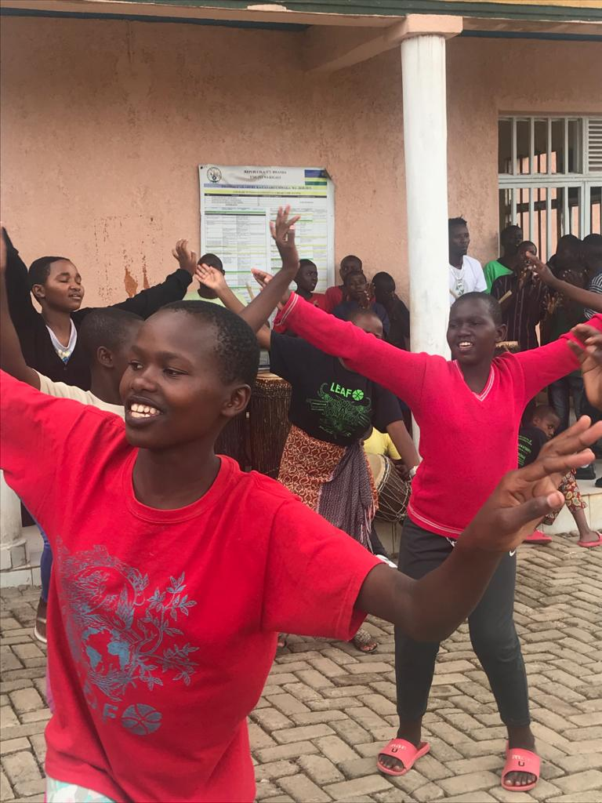
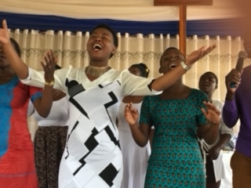
The Church in Rwanda

Slide 2
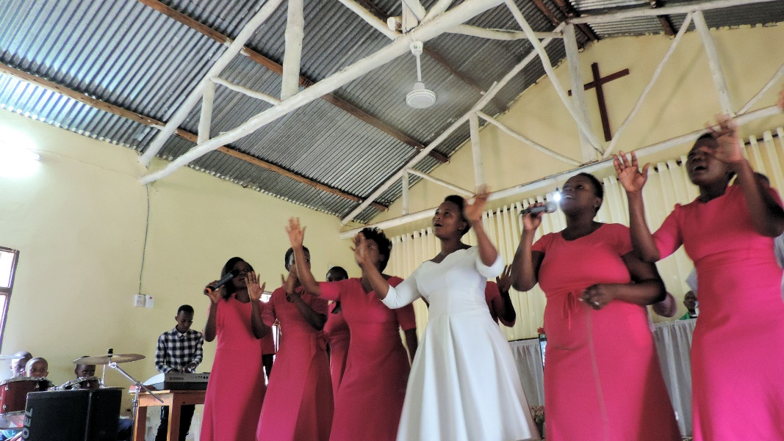

Slide 3
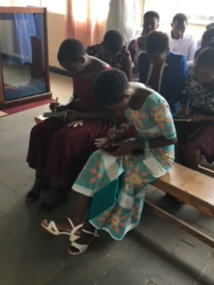

Slide 4
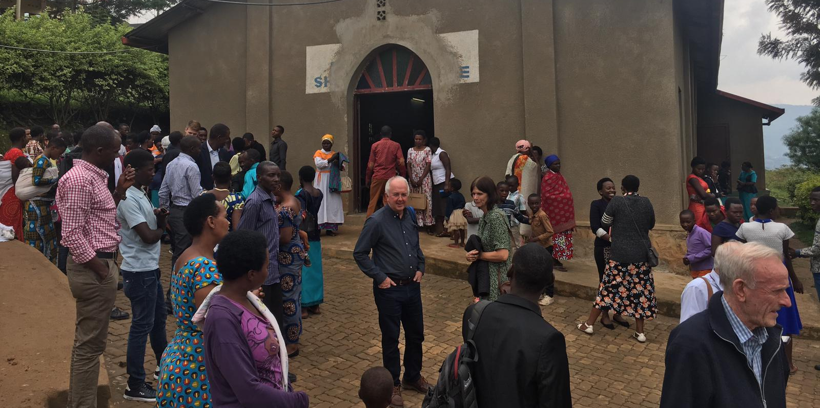
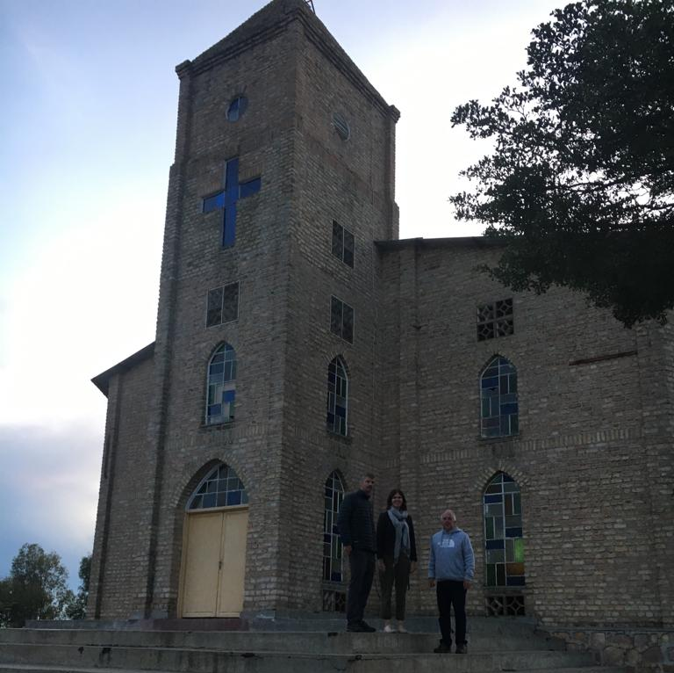
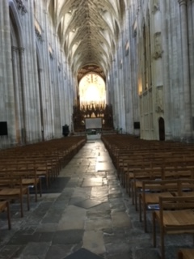
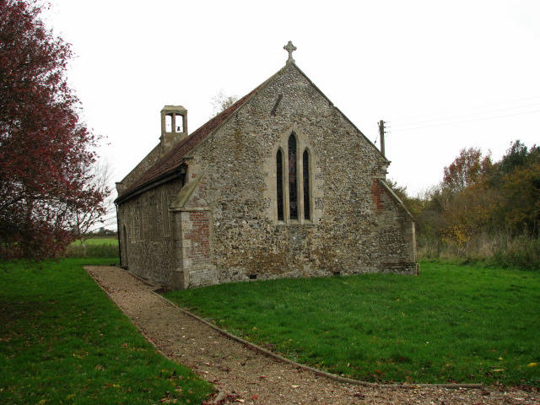

Slide 5
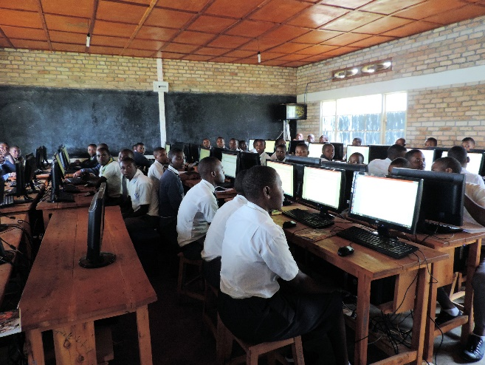
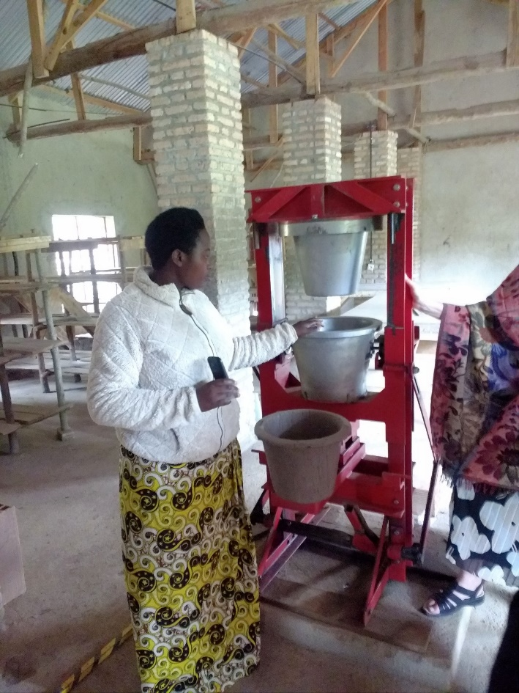
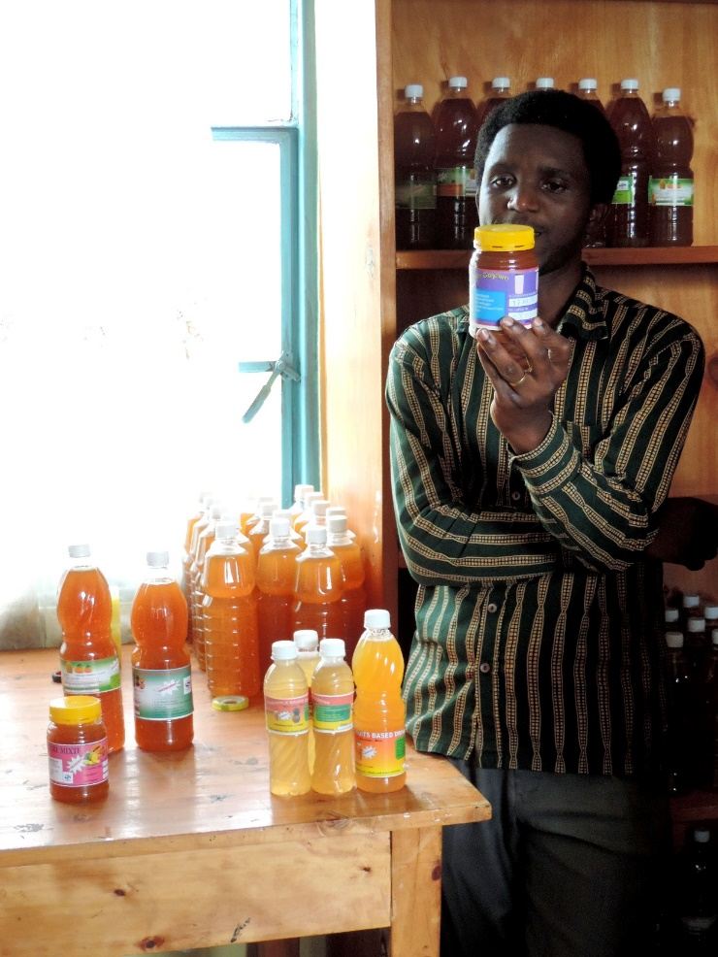

Slide 7
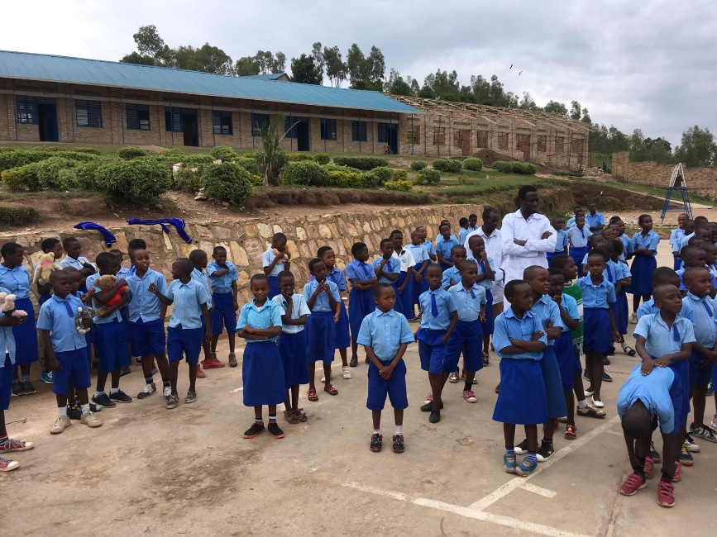

Slide 8
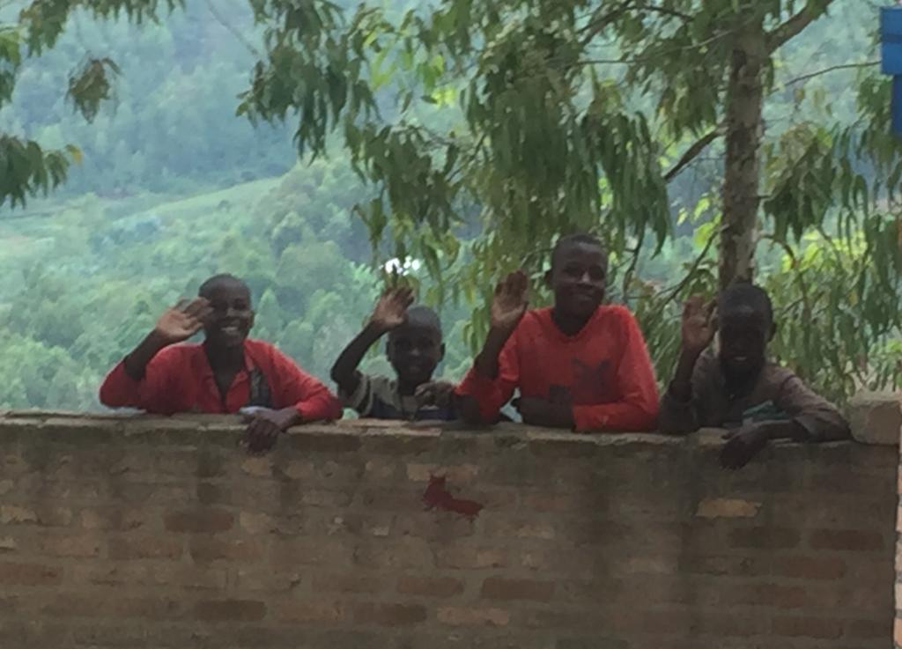
A Prayer for Rwanda
Dear God
We pray for all the children in Rwanda, that you will keep them safe and happy.
We pray for their teachers who work so hard, just like our teachers in the UK.
We pray for all children in Britain and across the world, that they will be healthy, safe and know that you love them every day.
Help us to learn from the example of the hardworking churches of Rwanda that help families and communities in so many ways.
Amen

